Slide 1
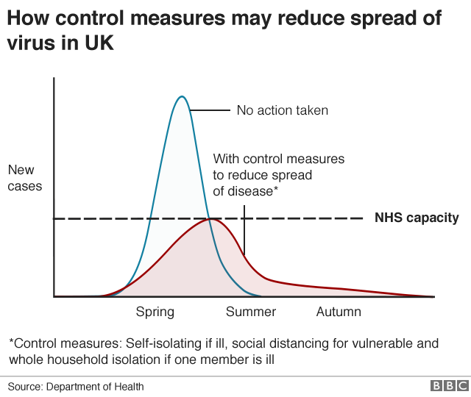
Medium-Duration Energy Storage
… explained using indicative graphs without numbers on the axes.
CAES – a wide set of technologies with great potential.
Prof. Seamus D. Garvey, CEng, PhD, MIET, MIEEE, FIMechE Dr. Bruno Cardenas, PhD.
Professor Seamus D. Garvey, University of Nottingham
Medium Duration Energy Storage in the Net Zero UK, March 23, 2020

Slide 2
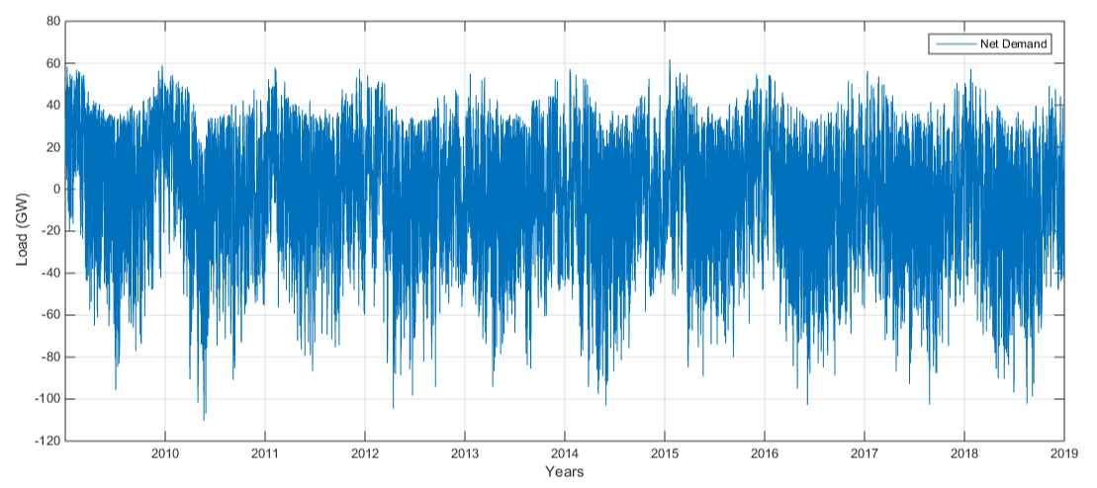
What Energy Storage Does
Energy Storage redistributes energy in time to help reconcile the different between the profiles of natural generation* and natural demand.
Scaled Net Demand over 10 years with 75% generation from wind, 25% generation from PV and 10% over-capacity.
* Natural generation includes some degree of over-capacity
Medium Duration Energy Storage in the Net Zero UK.

Slide 3
Decomposing the duty of E.S.
We can decompose net-demand into different frequency components.
Use a log. scale for frequency … Octaves (×2), Third-Octaves (×1.25992), Semi-tones (×1.05946)
Discharge times of relevance range from ~0.1s to ~15,000 hrs (5 × 10⁷ s) … 29 Octaves.
1 p.u.
~1 p.u. × (1 week)
Power Requirement → (per octave)
Energy Requirement → (per octave)
log(discharge-duration) →
Medium Duration Energy Storage in the Net Zero UK.

Slide 4
Different Timescales ⇔ Different Technology Sets
Flywheels and super-capacitors
Synthetic- and bio- fuels (including hydrogen)
Battery technologies
Cost-per-semitone →
Thermo-mechanical Technologies
log(discharge-duration) →
Medium Duration Energy Storage in the Net Zero UK.

Slide 5
Different Timescales ⇔ Different Technology Sets
Marginal cost to the nation of not progressing medium-duration energy storage
Cost-per-semitone →
Very-short duration storage
Short duration energy storage
Medium-duration energy storage (~4 hrs → ~200 hrs)
Long duration energy storage
log(discharge-duration) →
Medium Duration Energy Storage in the Net Zero UK.

