Slide 1
Energy Storage
for
High Penetrations of Offshore Wind
Needs and Solutions
Henrik Stiesdal, 01.03.20

Slide 2
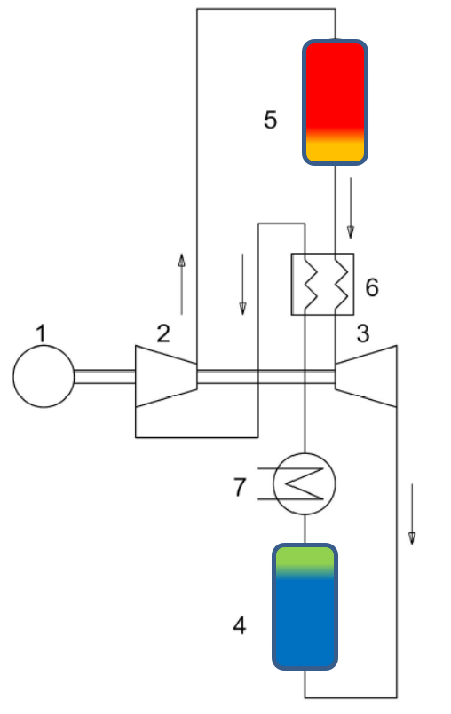
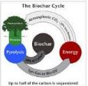
Stiesdal A/S Framework
Stiesdal A/S
Purpose
  The purpose of the Company is to contribute to climate change mitigation by developing and commercializing solutions to key challenges.
  Relevant solutions need to
    Have a potential for high impact on climate change mitigation
    Be suitable for industrialization
    Be suitable for the skills and capabilities of the Company
Stiesdal Offshore
Technologies A/S
Stiesdal Storage
Technologies A/S
Stiesdal Fuel
Technologies A/S
Project
Target
Means
Tetra
Unlimited low-cost offshore wind energy
Industrialized fixed & floating foundations
GridScale
Unlimited share of renewables on grid
Storage system w. 10h – 10d capacity
SkyClean
Carbon capture and sequestration
Carbon-negative jet fuel

Slide 3
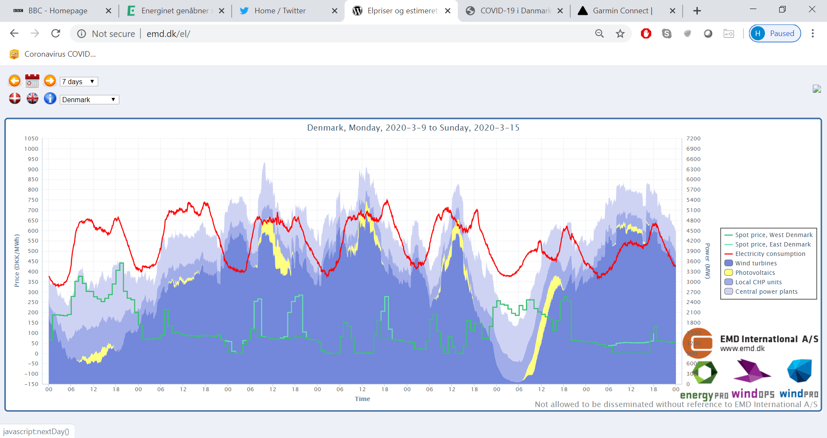
Key motivation for storage – renewable power integration
Source: EMD International

Slide 4
Market mechanisms reduce the value of wind production
Source: Energinet.dk

Slide 5
So – how much storage do we need?

Slide 6
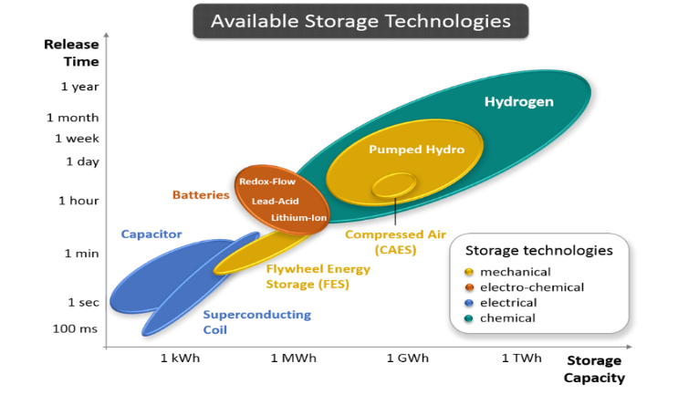
Some available storage technologies
Round-trip
efficiency
35-40%
50-65%
Seasonal
Mid-term
Short-term
(Ammonia)
Thermal
Source: IIDST

Slide 7
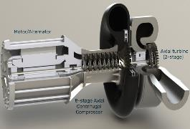
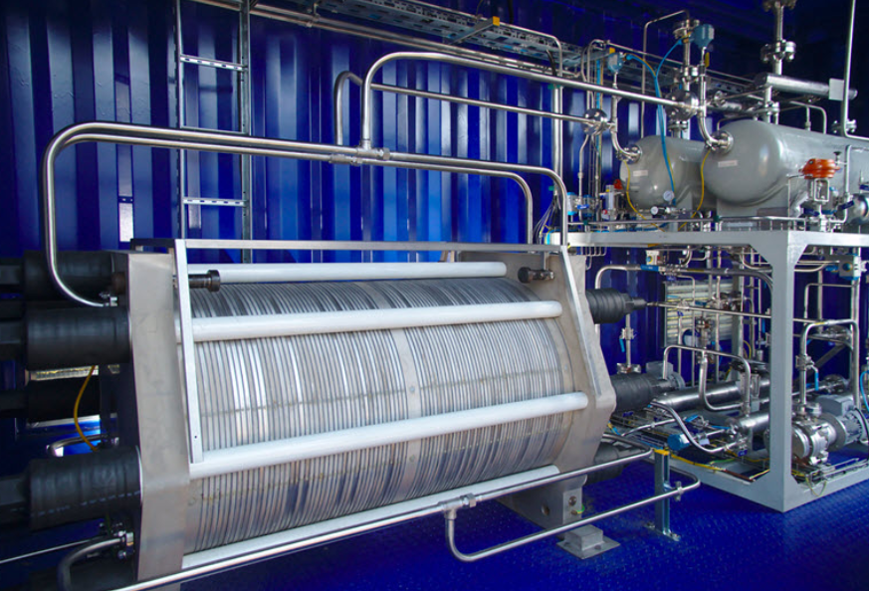
Two of the key storage technologies for offshore wind integration
Thermal energy storage
Ammonia energy storage
Hot reservoir
Power in
Heat pump
Heat engine
Power out
Cold reservoir
Water
Electrolysis
Power in
Ammonia
synthesis
Ammonia
reservoir
Heat engine
Power out
Nitrogen
separation
Air
Picture credit: Brayton Energy, HydrogenPro

Slide 8
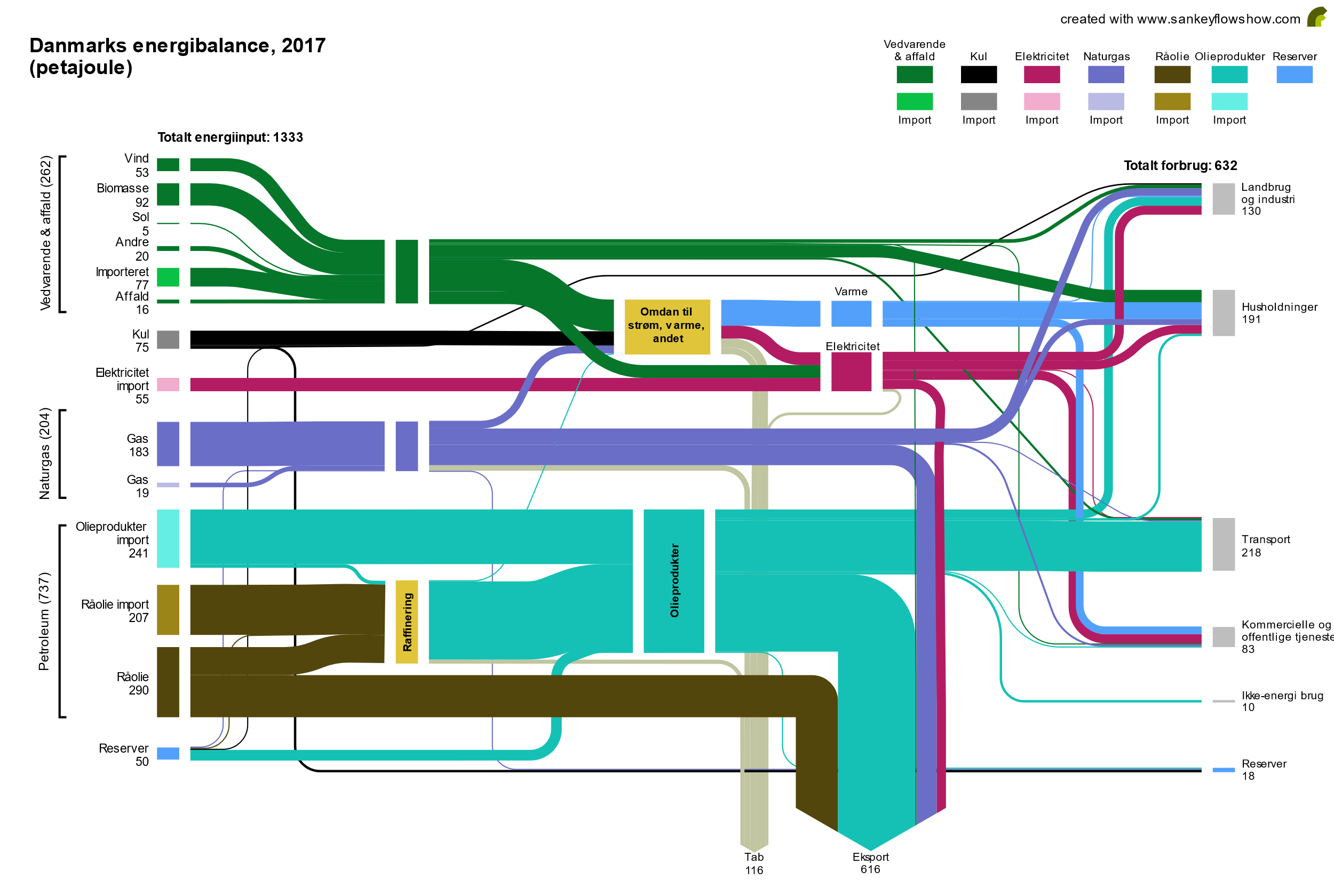
The Danish energy system, 2017
Wind and solar PV
Biomass and waste

Slide 9
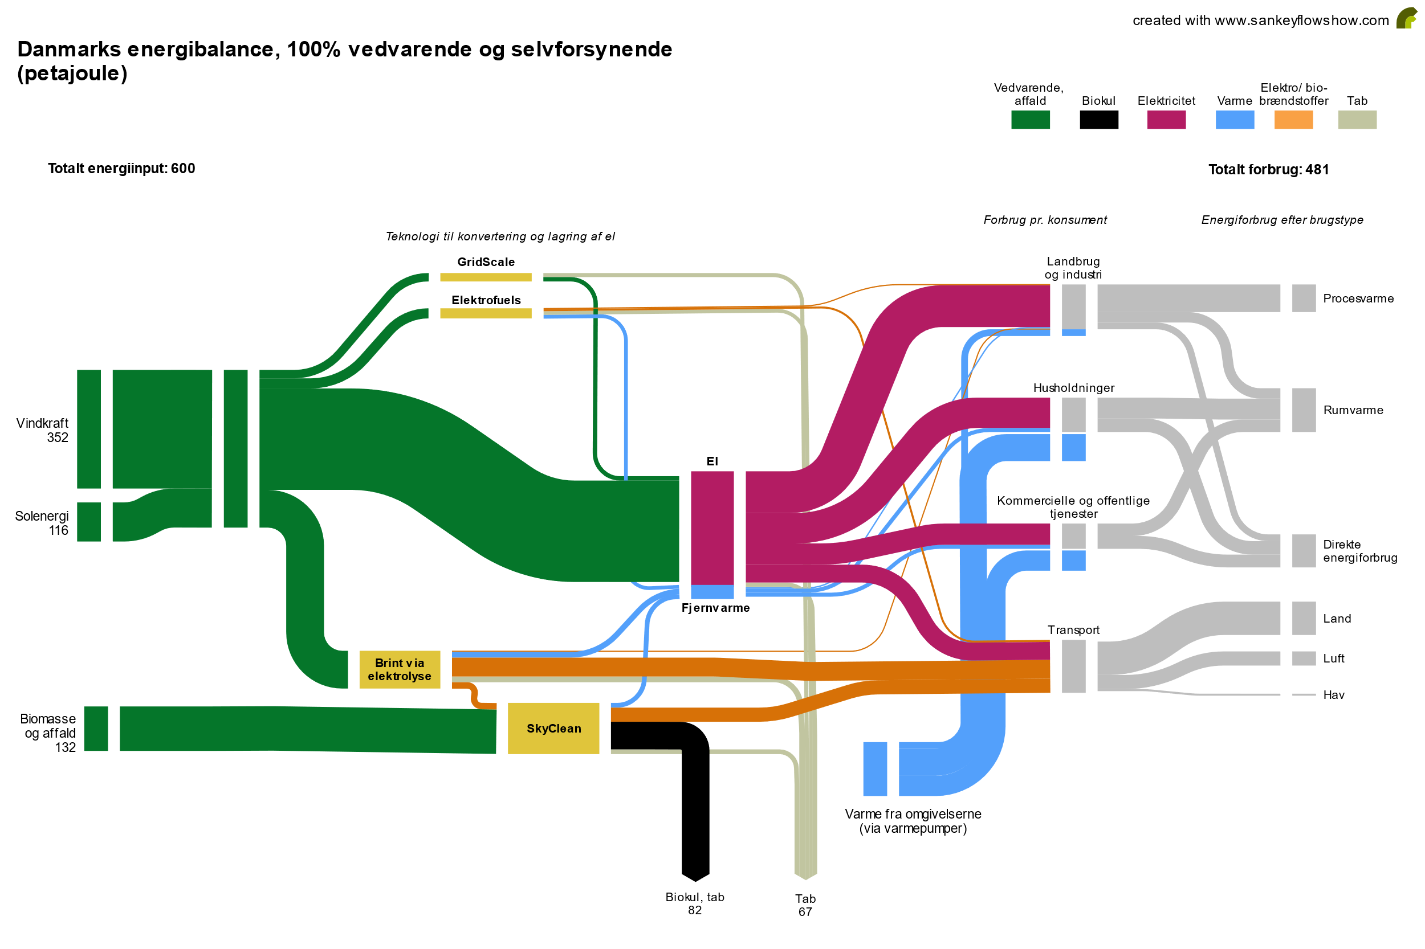
The Danish energy system, 2030
Wind and solar PV
Biomass and waste

Slide 10
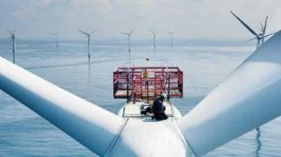
The Energy Island concept
To reach 2030 target Denmark needs –
11.5 GW of offshore wind power
5 GW of onshore solar PV
The transmission and variability challenge
There is no feasible way to absorb 10 GW of offshore wind power from the Danish west coast into the grid
The variability challenge is immense, with infeed varying from close to zero to several times over actual load
The solution
A 10 GW energy island with storage and PtX production

Slide 11
Dimensioning the Energy Island

Slide 12
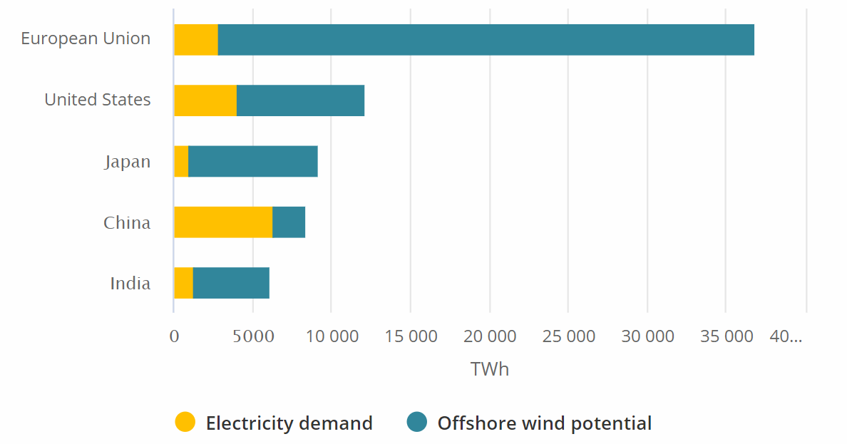
The Energy Island PtX system is also needed for transportation
Demand beyond electricity alone is huge
Denmark requires ~14 GW of offshore wind for pure electricity
If all PtX for Maersk fleet were to be supplied out of Denmark alone, the added demand would be 40 GW
Source: IEA, Offshore Wind Potlook 2019

Slide 13
In summary –
100% penetration with wind and solar PV
It is doable – provided we have both medium- and long-term storage
Offshore wind will be the dominant source of renewable electricity at Northern European latitudes, with a target share of 70+% of all renewable capacity
Key solution elements
Energy storage comprising mid-term storage (thermal, liquid air and similar) and long-term storage (PtX, e.g. ammonia)
PtX can also paly dominant role in green transition of heavy transport
Storage is a key enabler of the green transition!

Slide 14
Thanks for your attention
Henrik Stiesdal
hst@stiesdal.com

