Slide 1
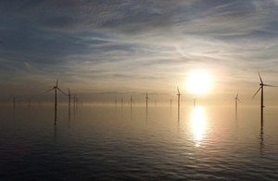

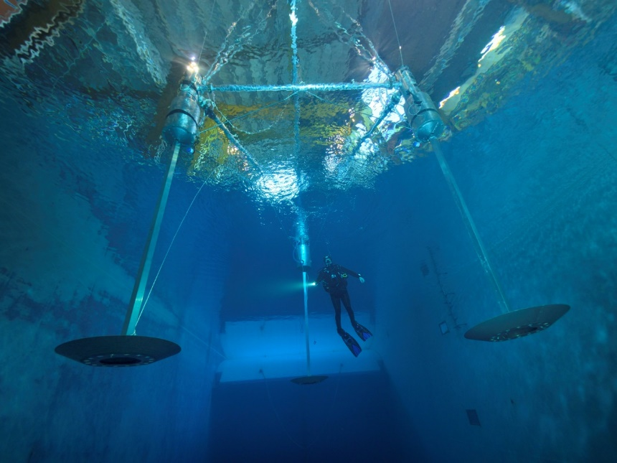


ENERGY STORAGE INTEGRATED WITH UK Offshore Wind
£39.65/MWh
Seamus GARVEY

Slide 2
Contents of this talk
MOTIVATIONS for integrating Energy Storage with OSW
THREE Different classes of solution
The WindTP solution: Challenges and Features
Economics of energy storage integrated with OSW.
Closing Remarks
Medium Duration Energy Storage in the Net Zero UK.

Slide 3
Contents of this talk
MOTIVATIONS for integrating Energy Storage with OSW
THREE Different classes of solution
The WindTP solution: Challenges and Features
Economics of energy storage integrated with OSW.
Closing Remarks
Medium Duration Energy Storage in the Net Zero UK.

Slide 4
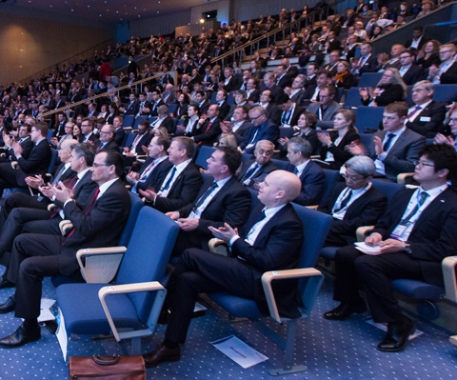
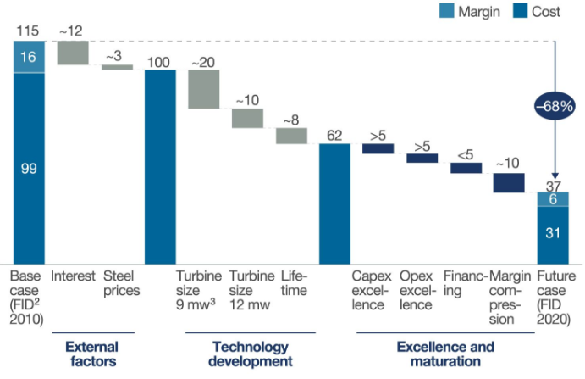
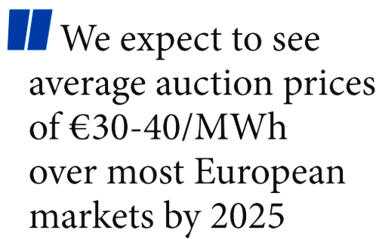
Motivations: Future energy scenarios
Be prepared for wind power exceeding all expectations!
Near-future predictions of future costs for OSW look promising.
Global Offshore
Wind Conference
London, June 2017
McKinsey Report on Offshore Wind,
June 2017
€115/MWh 2010
reduces to
€36/MWh 2020
(FID dates)
Medium Duration Energy Storage in the Net Zero UK.

Slide 5
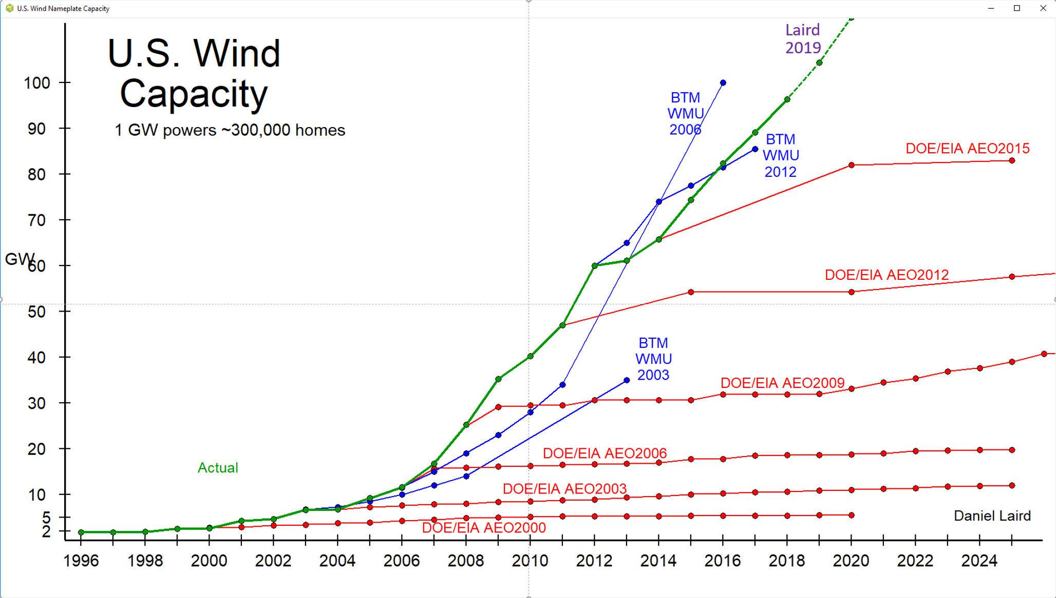
Motivations: Future energy scenarios
Be prepared for wind power exceeding all expectations!
From Daniel Laird, Keynote talk at OSES2019, Brest, France, July 2019

Slide 6
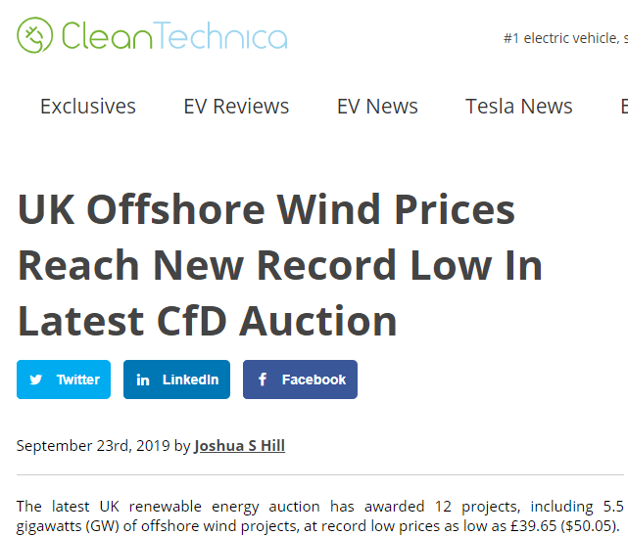
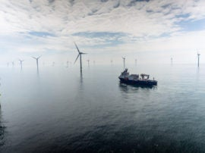
Motivations: Future energy scenarios
Be prepared for wind power exceeding all expectations!
https://cleantechnica.com/2019/09/23/uk-offshore-wind-prices-reach-new-record-low-in-latest-cfd-auction/
Medium Duration Energy Storage in the Net Zero UK.

Slide 7
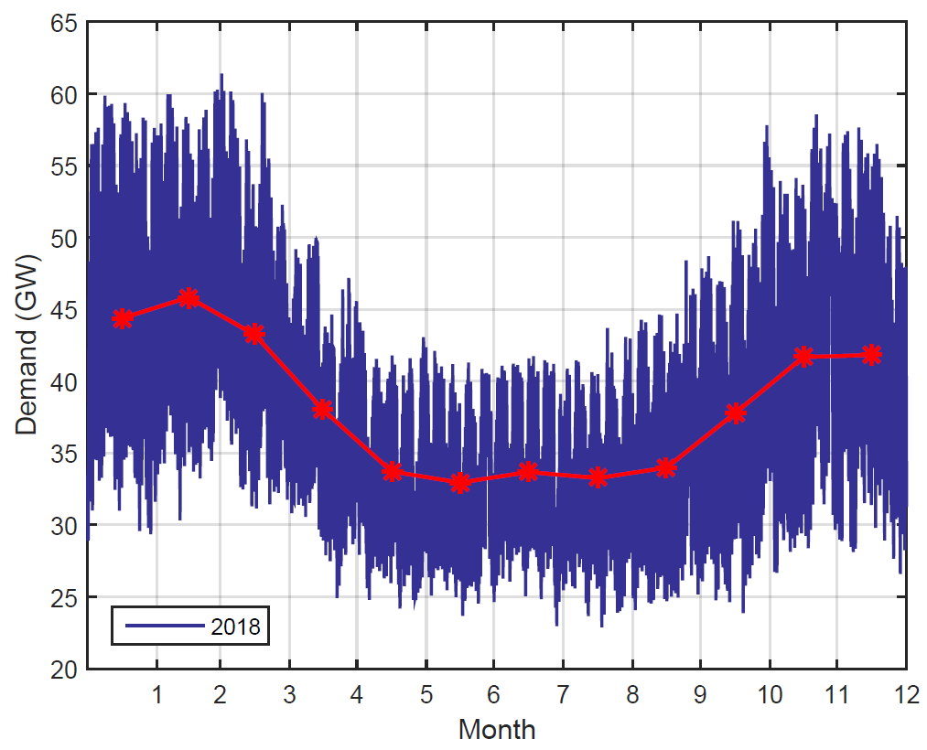
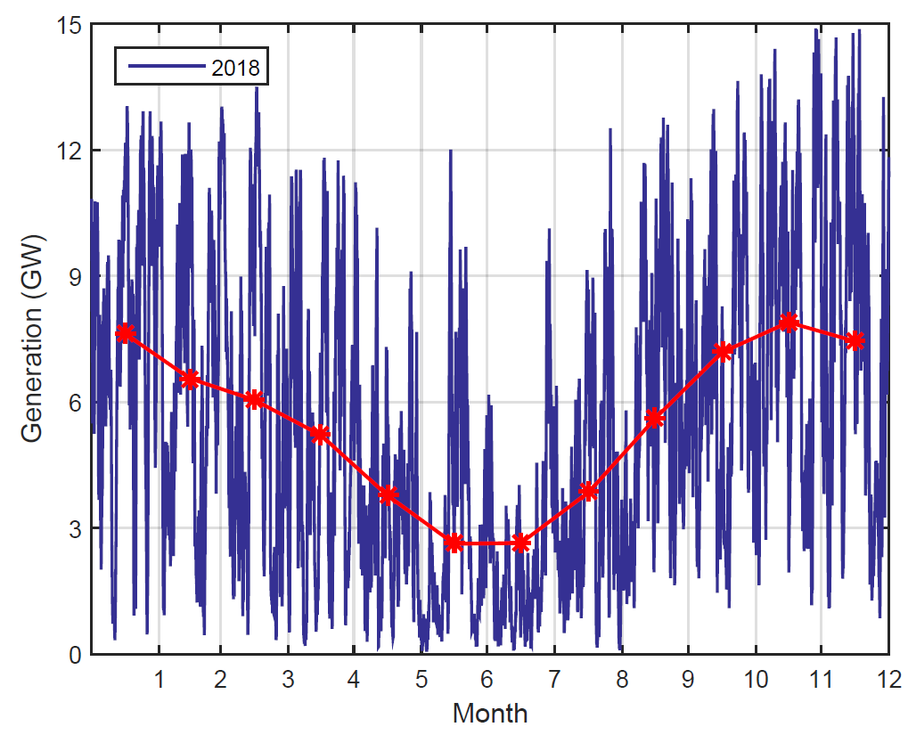
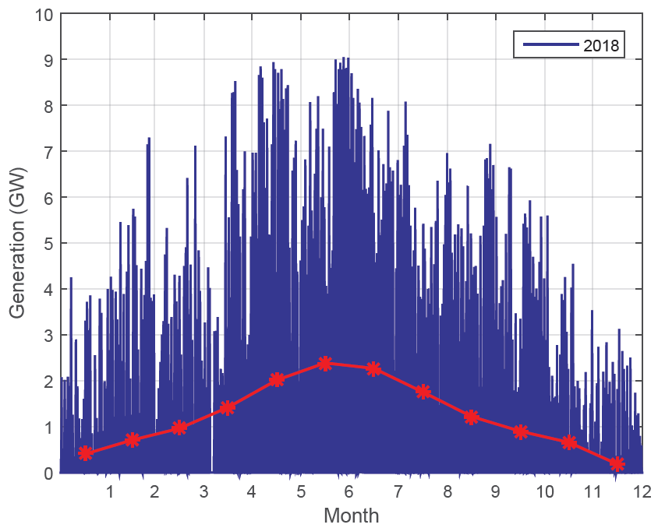
Motivations: Why E.S. with Wind?
Demand does not correlate perfectly with availability of wind power.
Electricity Demand
Wind Generation
Solar PV Generation
Demand is seasonal. Wind power is seasonal (and in phase with demand in the UK). PV is in anti-phase.
Medium Duration Energy Storage in the Net Zero UK.

Slide 8
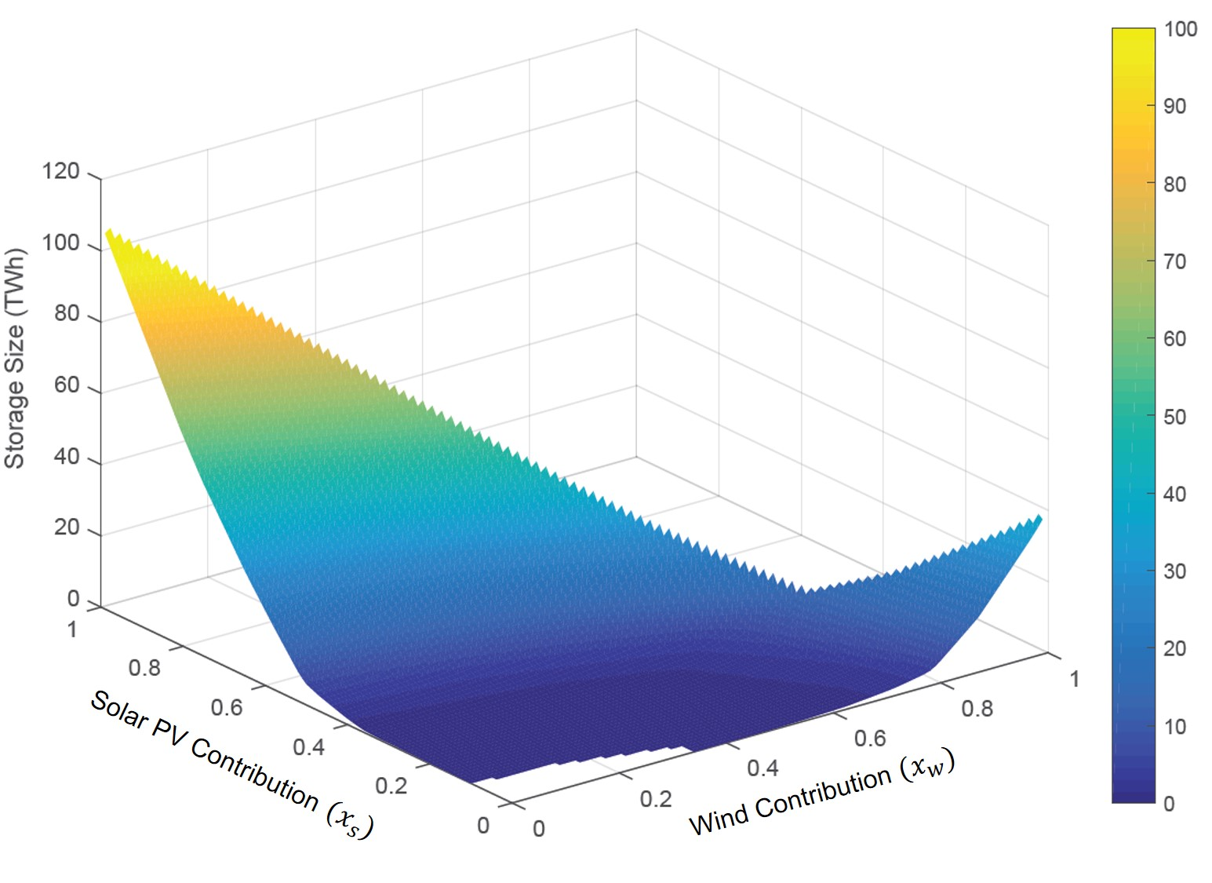
Motivations: Why E.S. with Wind?
Demand does not correlate perfectly with availability of wind power.
100%
Magnitude of storage capacity
to reconcile supply with demand.
With 0% over-capacity
Y2018 needs ~15TWh
Equivalent to 390 hrs
Penetration of Solar (net) →
23.6% of all energy consumed has passed through storage.
Penetration of Wind (net) →
100%
Cardenas et. Al., Energy storage for a high penetration of renewables. OSES2019, Brest, July 2019.

Slide 9
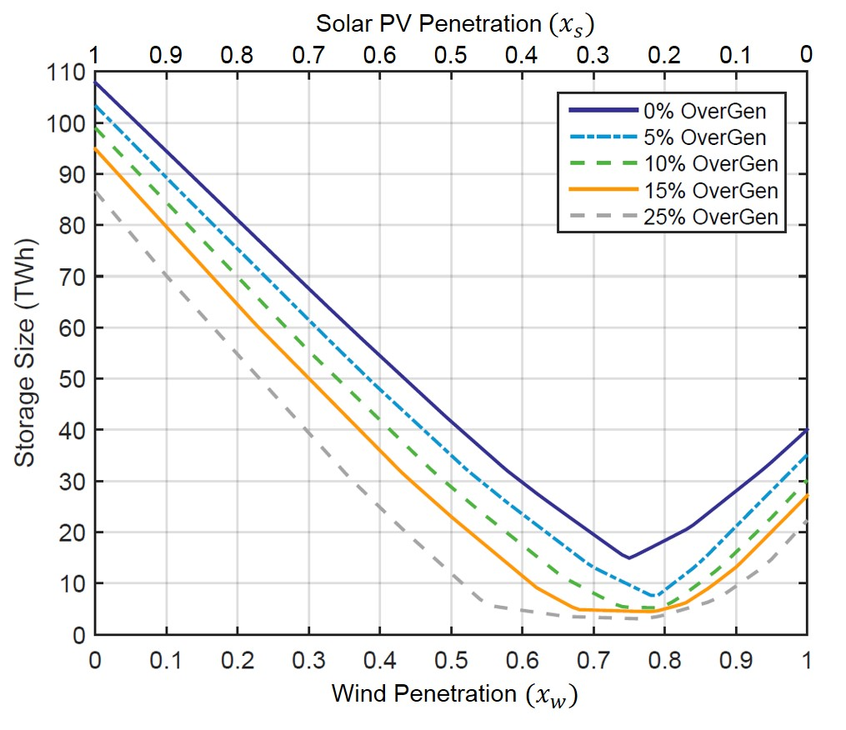
Motivations: Why E.S. with Wind?
Demand does not correlate perfectly with availability of wind power.
With a fully-(wind+solar) powered UK,
The capacity of storage required depends on the wind/solar mix AND on the degree of net over-capacity.
Y2018 needs ~4.5TWh with 5% over-generation … around 120 hrs demand.
The optimal ratio of wind/solar changes to 78:22 for 5% over-gen^{n.}
21.8% of all energy consumed has passed through storage.
Cardenas et. Al., Energy storage for a high penetration of renewables. OSES2019, Brest, July 2019.

Slide 10
Motivations: Why E.S. with Wind?
If energy storage is being motivated largely by offshore wind, should it integrated with offshore wind?
Possible improvement in transmission line utilisation
Possible savings in power-conversion equipment
Possible reduction in overall losses
The offshore environment is conducive!
Space, thermal ballast, hydrostatic pressure, easy to manage heavy things
Medium Duration Energy Storage in the Net Zero UK.

Slide 11
Contents of this talk
MOTIVATIONS for integrating Energy Storage with OSW
THREE Different classes of solution
The WindTP solution: Challenges and Features
Economics of energy storage integrated with OSW.
Closing Remarks
Medium Duration Energy Storage in the Net Zero UK.

Slide 12
Three DIFFERENT CLASSES
Class #3 ‘Not really integrated at all! “Co-Located”
Wind turbines generate electricity, electricity is transformed to something else and back.
Direct Consumption
Electricity
Consumer
Gearbox
Generator
(??)
Energy through storage
E→X
X→E
Cnvrtr.
Cnvrtr.
In the best cases, at least the energy store is integrated.
Energy Store (X)

Slide 13
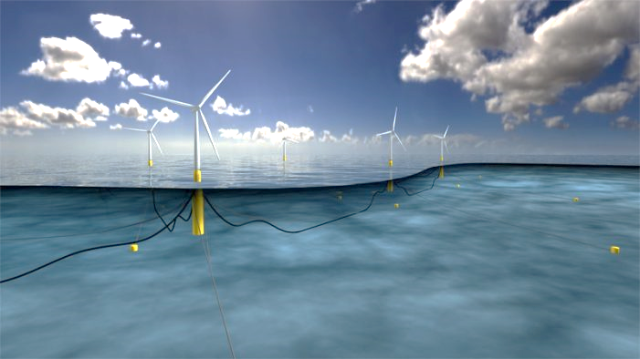
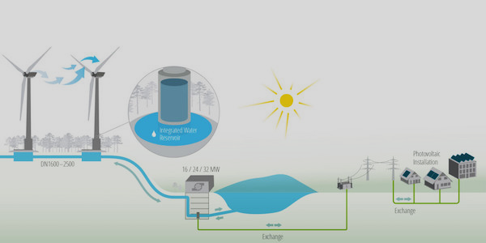
Three DIFFERENT CLASSES
Class #3 ‘Not really integrated at all! “Co-Located”
Wind turbines generate electricity, electricity is transformed to something else and back.
/www.poweronline.com/doc/statoil-launches-batwind-battery-storage-for-offshore-wind-0001
cleantechnica.com/2016/11/14/ge-forges-ahead-
worlds-first-wind-hydro-storage-project/
Medium Duration Energy Storage in the Net Zero UK.

Slide 14
Three DIFFERENT CLASSES
Class #3 ‘Not really integrated at all! “Co-Located”
Wind turbines generate electricity, electricity is transformed to something else and back.
Ian Crossley
Compressed Air Energy Storage for Offshore Wind Turbines.
Windpower Monthly. Feb 1, 2018
Proposes storage in an articulated-base “floating wind” type turbine support.

Slide 15
Three DIFFERENT CLASSES
Class #2 Parallel Power conversion
Rotor power split mechanically between direct generation and conversion to-&-from storage.
Direct Consumption
Generator
Electricity
Consumer
M→E
Gearbox
(??)
M→X
X→E
Cnvrtr.
Energy Store (X)
Cnvrtr.
Energy through storage
Medium Duration Energy Storage in the Net Zero UK.

Slide 16
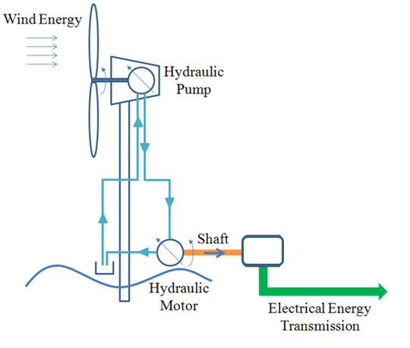
Three DIFFERENT CLASSES
Class #2 Parallel Power conversion
Rotor power split mechanically between direct generation and conversion to-&-from storage.
C Qin, E Innes-Wimsatt & E. Loth. Hydraulic-electric hybrid wind turbines: tower mass savings and energy storage capacity. Renewable Energy, 99, Dec. 2016,
This 2016 paper from University of Virginia proposes a hydraulic transmission with the high-speed end connected simultaneously to an air-compressor/expander and an electrical generator.
Energy Storage
System
Electric
Generator

Slide 17
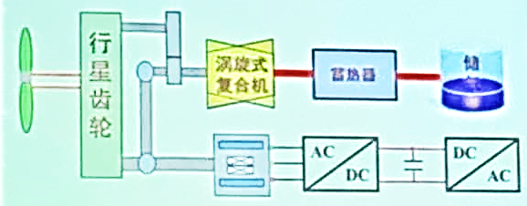
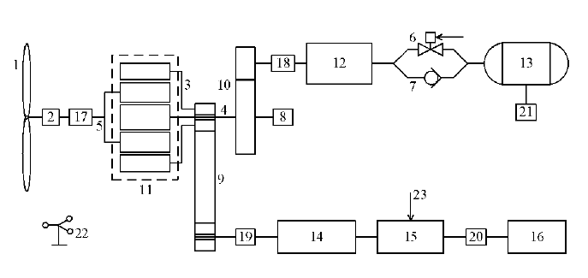
Three DIFFERENT CLASSES
Class #2 Parallel Power conversion
Rotor power split mechanically between direct generation and conversion to-&-from storage.
Air Compress^{n}/Expans^{n} Line
CN2011104111118A.
Prof. Ke Li of Shan Dong University proposes a mechanically-coupled hybrid power take-off with some power being sent directly to generation and some being directed through (compressed air) storage.
Electrical Generation Line
Mechanically-coupled mini-type hybrid wind power generating system

Slide 18
Three DIFFERENT CLASSES
Class #1 FULLy integrated storage with wind
All rotor power is converted to “X” (storable) and then subsequently to electricity.
Direct Consumption
M→X
X→E
Electricity
Consumer
Cnvrtr.
Cnvrtr.
Energy Store (X)
Energy through storage

Slide 19
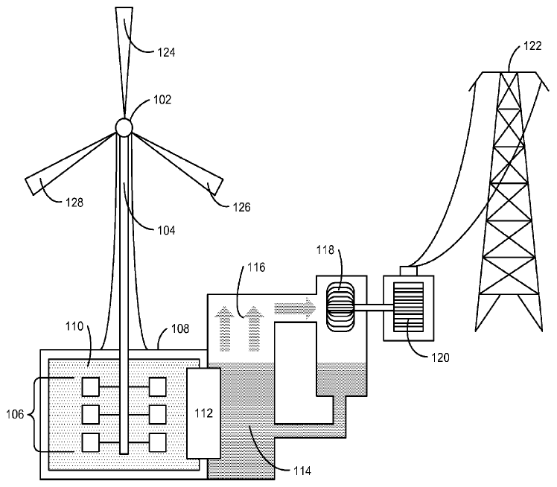
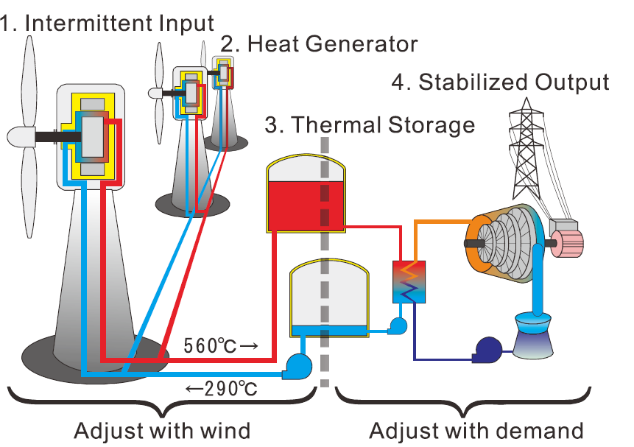
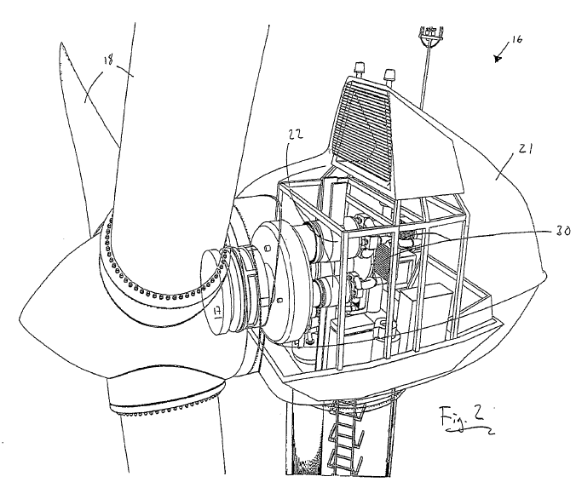
Three DIFFERENT CLASSES
Class #1 FULLy integrated storage with wind
All rotor power is converted to “X” (storable) and then subsequently to electricity.
US 2012/0326445 A1, June 2011.
Concept study of wind power utilizing direct thermal energy conversion and thermal energy storage Toru Okazakiª, Yasuyuki Shirai^{b}, Taketsune Nakamura^{b} Renewable Energy, 83, 332-338. Nov. 2015
WO 2007/136765 A2. Eric Ingersoll.
Wind Turbine System.
Compresses air directly

Slide 20
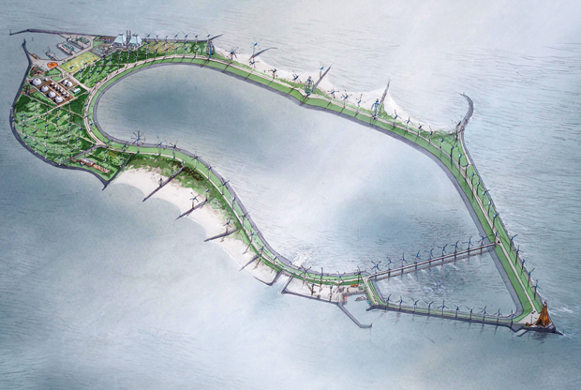
Three DIFFERENT WAYS
There are three main (thermo-)mechanical options for full integration of energy storage with (onshore or offshore) wind:
https://spectrum.ieee.org/energy/renewables/
4-new-ways-to-store-renewable-energy-with-water
Pump water uphill
Compress air
Pump heat

Slide 21
Contents of this talk
MOTIVATIONS for integrating Energy Storage with OSW
THREE Different classes of solution
The WindTP solution: Challenges and Features
Economics of energy storage integrated with OSW.
Closing Remarks
Medium Duration Energy Storage in the Net Zero UK.

Slide 22
: How IT Works
WindTP
Start by understanding a hydraulic transmission between main rotor and generator with a high speed ratio ...
Hydraulic Pump
Hydraulic Motor
Generator
Fluid Flow
G
… and then replace the hydraulic fluid with a gas!
Medium Duration Energy Storage in the Net Zero UK.

Slide 23
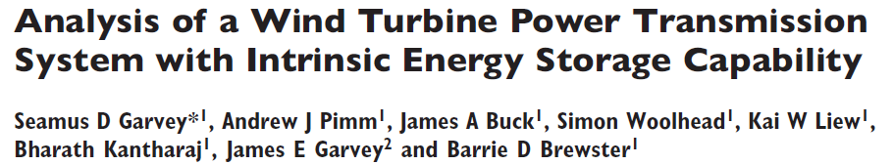
: How IT Works
WindTP
WindTP
is a power transmission system for wind turbines that takes power in directly from the rotor and delivers output power directly to the grid.
WindTP
employs reversible thermal pumping to enable the storage of ~100hrs of rated output capacity at marginal costs much below the cost of the wind turbine itself. This storage capacity with batteries would cost ~25 times as much as the wind turbine.
http://multi-science.atypon.com/doi/pdf/10.1260/0309-524X.39.2.149

Slide 24
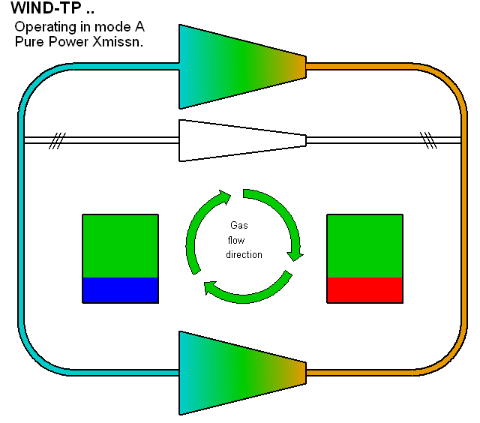
: How IT Works
WindTP
Adiabatic compression/expansion of a gas raises/lowers temperature.
Heat can be stored on the “HP” side and coldness can be stored on the “LP” side
Primary
Compressor
Important:
“LP” pressure is ~20 bar (2MPa)
“HP” pressure is ~500 bar (50MPa)
LP
Side
HP
Side
It is the high “LP” pressure is that makes it possible to fit the machine in a wind turbine nacelle.
Cold Store
Hot Store
Expander

Slide 25
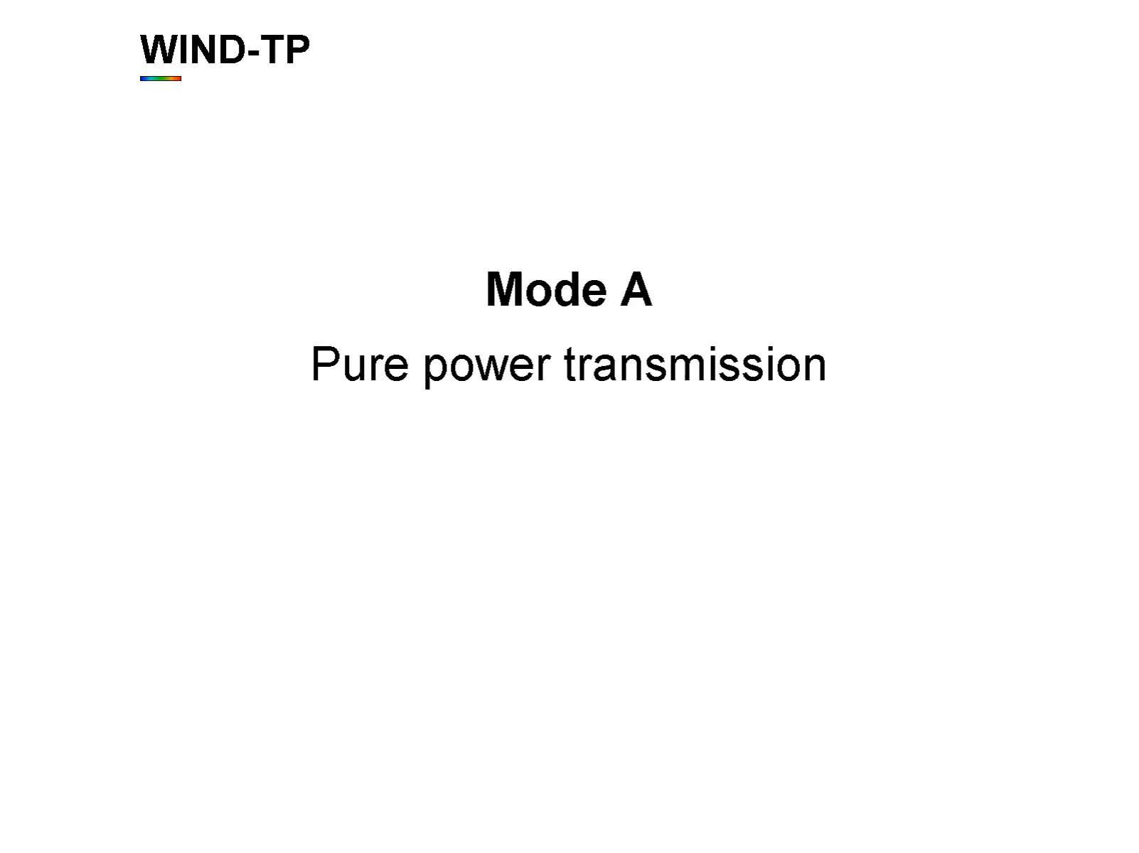
: How IT Works
WindTP

Slide 26
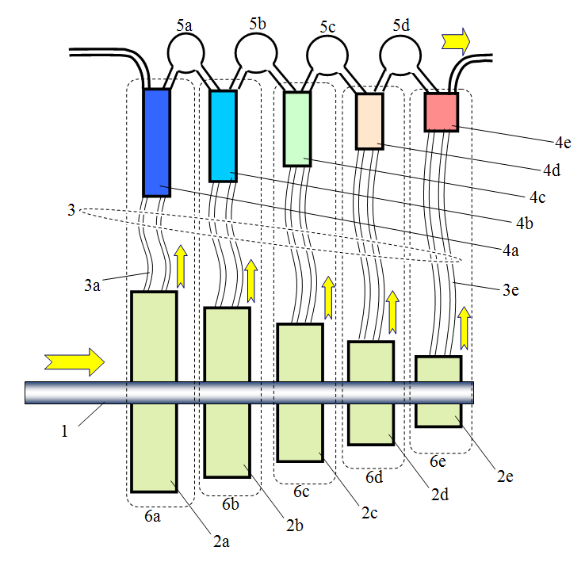
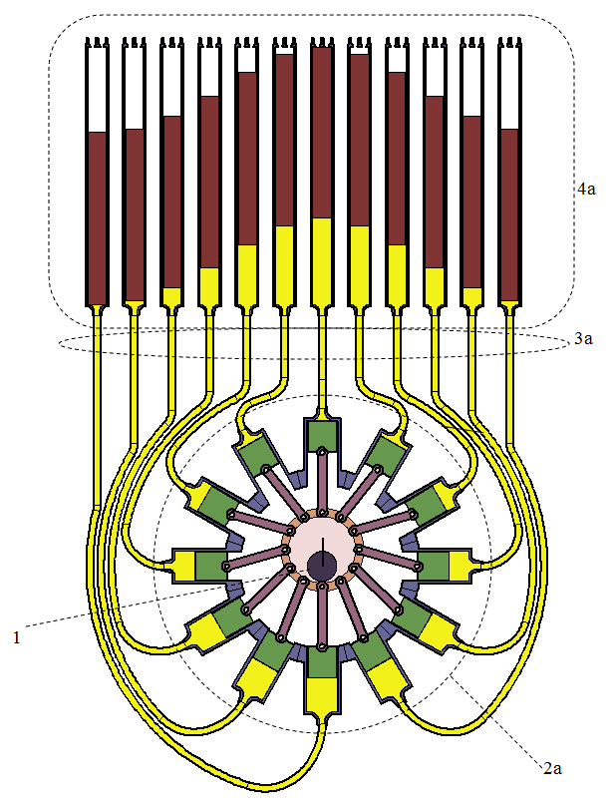
The Compressor
WindTP
Multi-stage machine. Each stage has similar Pressure ratio, different temperature.

Slide 27
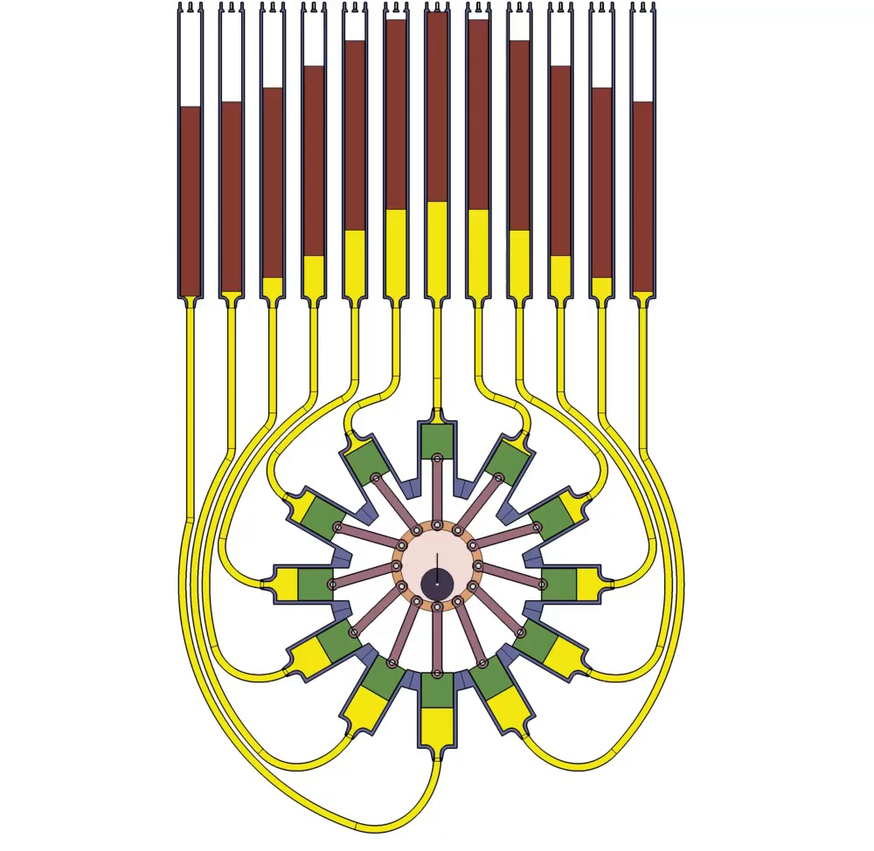
The Compressor
WindTP

Slide 28
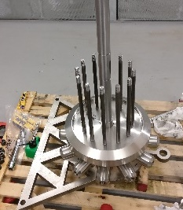
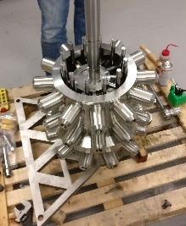
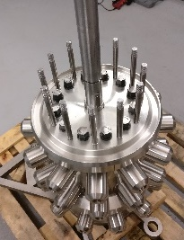
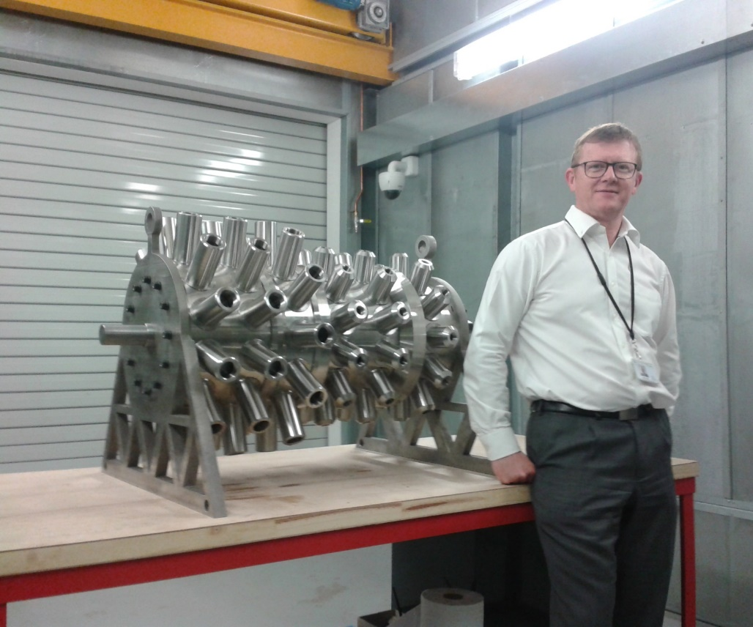
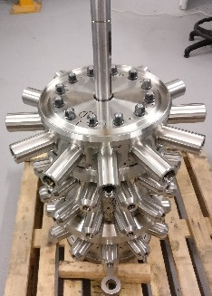
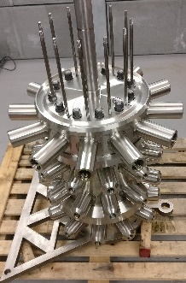
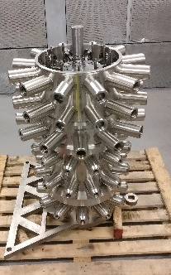
The Compressor
WindTP
This is the (4-stage) displacer for a~75kW machine. (~550kg).
Medium Duration Energy Storage in the Net Zero UK.

Slide 29
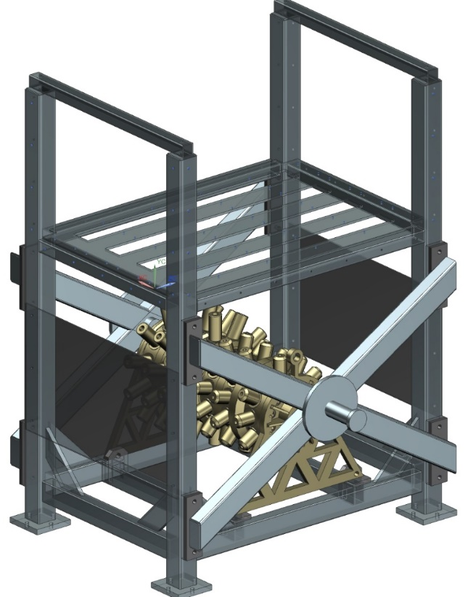
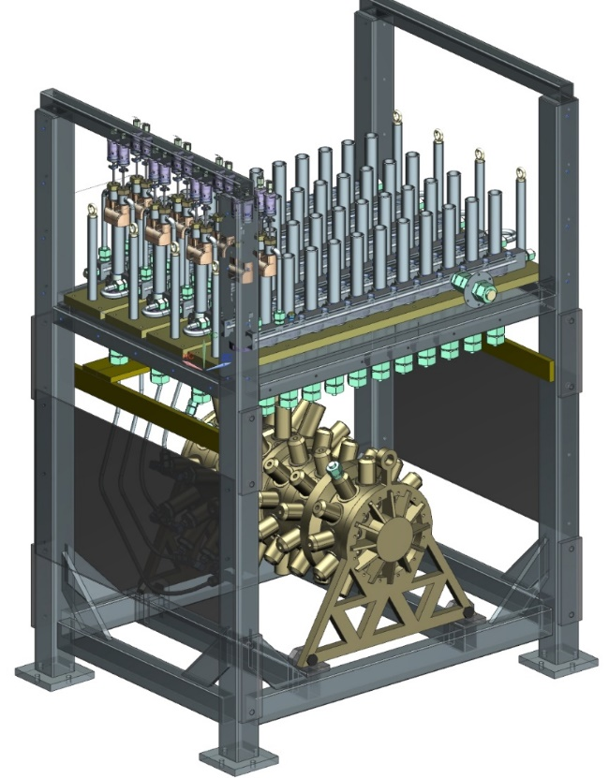
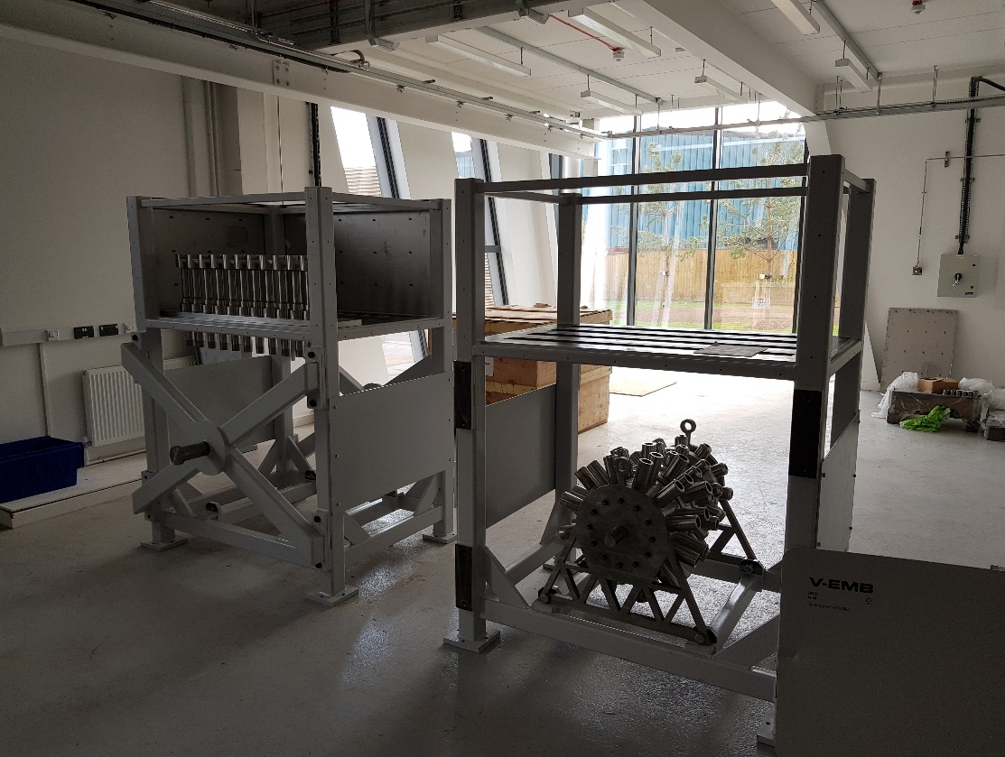
The Compressor
WindTP
Previews of the completed machine.
Medium Duration Energy Storage in the Net Zero UK.

Slide 30
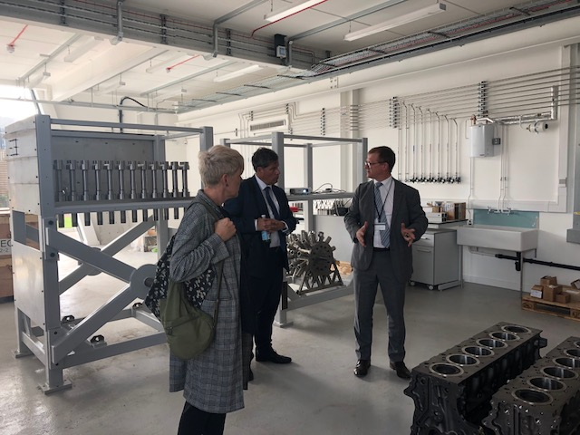
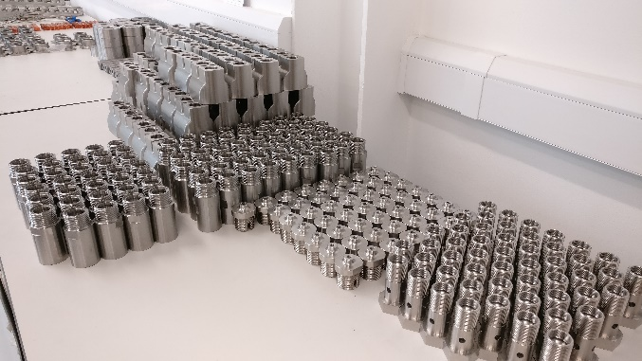
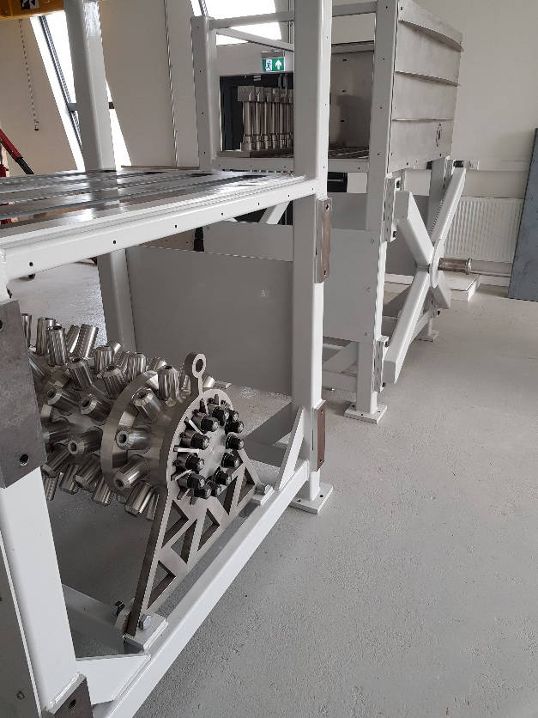
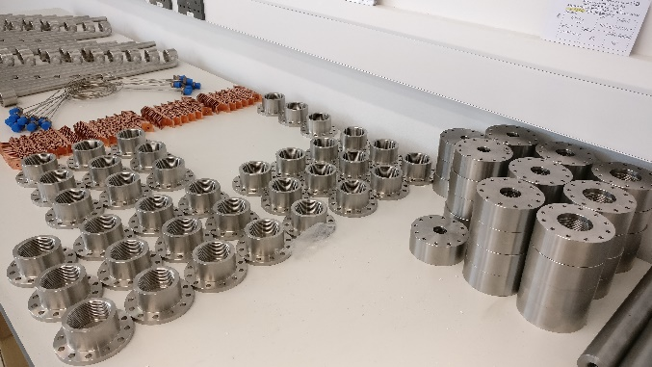
The Compressor
WindTP
Previews of the completed machine.
Medium Duration Energy Storage in the Net Zero UK.

Slide 31
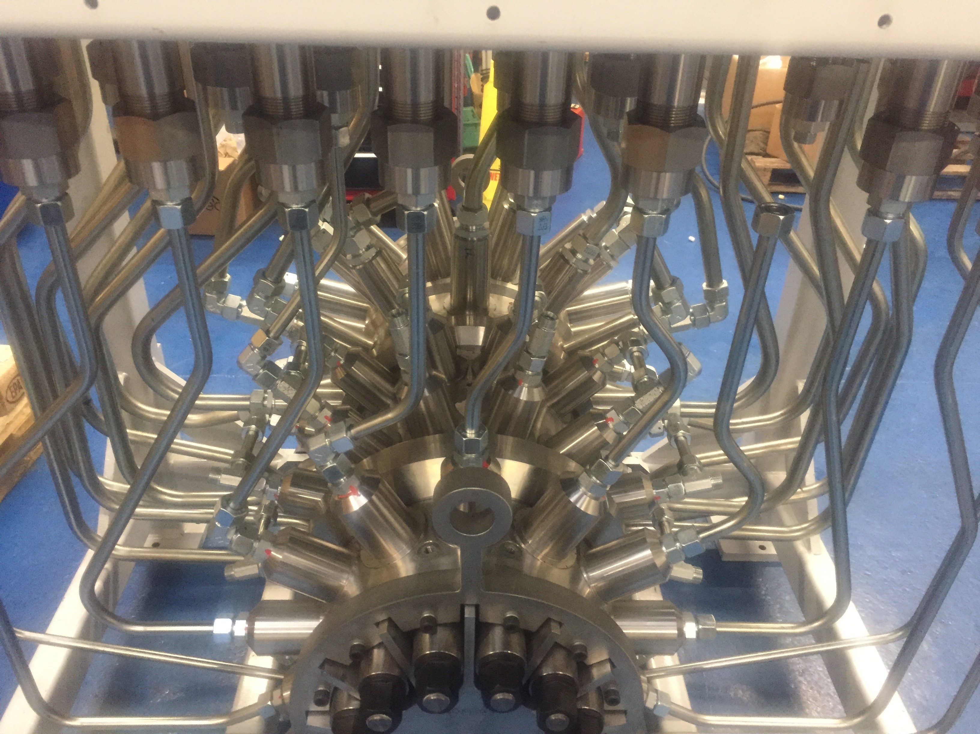
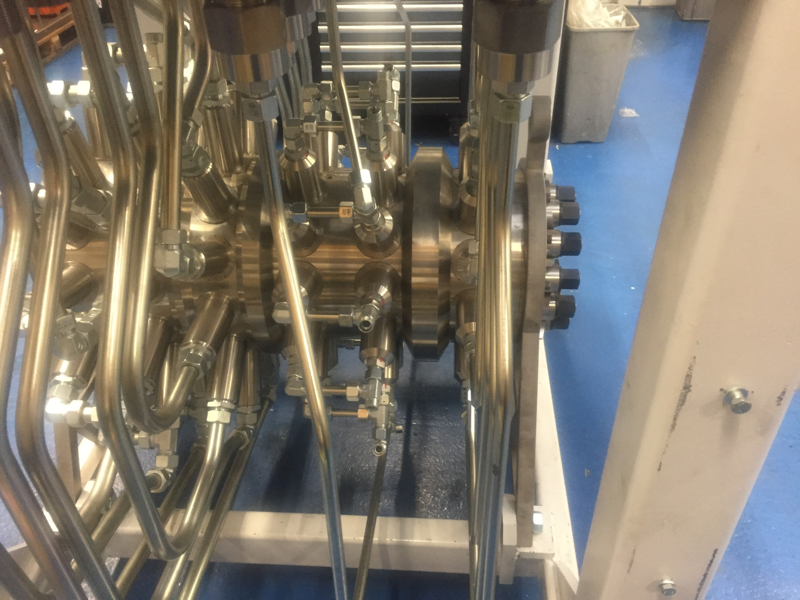
The Compressor
WindTP
Previews of the completed machine.
Medium Duration Energy Storage in the Net Zero UK.

Slide 32
Contents of this talk
MOTIVATIONS for integrating Energy Storage with OSW
THREE Different classes of solution
The WindTP solution: Challenges and Features
Economics of energy storage integrated with OSW.
Closing Remarks
Medium Duration Energy Storage in the Net Zero UK.

Slide 33
Economics of Integrated storage
Two Different efficiencies are relevant
η_{X}
Transmission efficiency: What fraction of input renewable energy (rotor work) is converted to output electricity if not passed through storage
η_{S}
Storage efficiency: Ratio between output energy if all passed through storage vs. output energy if none passed through storage.
Overall throughput efficiency: η_{T} = η_{X} × ((1 – χ_{i}) + (χ_{i} × η_{S}) )
η_{X}
The fully integrated storage solutions tend to have slightly lower
… but a considerably higher value of storage efficiency
η_{S}

Slide 34
Economics of Integrated storage
If high fractions of wind generation will pass through storage, a fully-integrated system will produce more output energy.
Integrated Storage
Standalone Storage
Garvey, Eames et. al.
On Generation Integrated Energy Storage
Energy Policy 86, 2015, pp544-551
http://multi-science.atypon.com/doi/pdf/10.1260/0309-524X.39.2.149

Slide 35
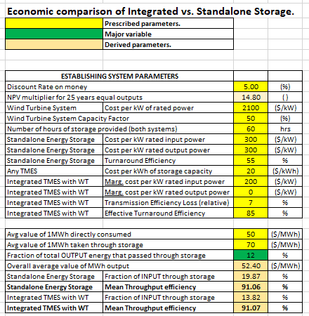
Economics of Integrated storage
It takes only some simple calculations with a spreadsheet to illustrate when the integrated storage solutions are better.
See www.TinyURL.com/
IES_economics

Slide 36
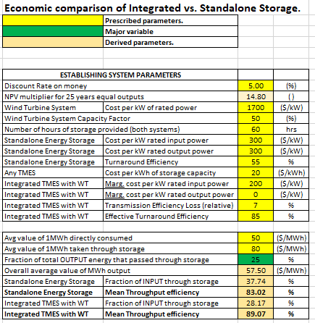
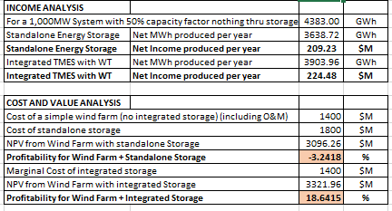
Economics of Integrated storage

Slide 37
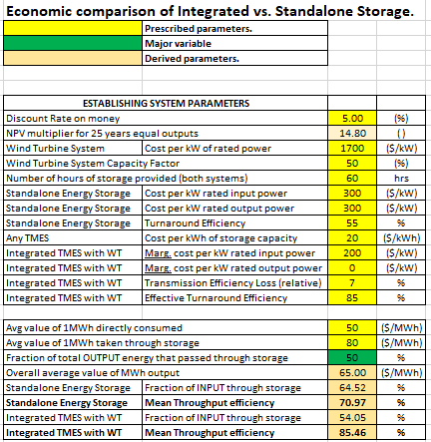

Economics of Integrated storage

Slide 38
Contents of this talk
MOTIVATIONS for integrating Energy Storage with OSW
THREE Different classes of solution
The WindTP solution: Challenges and Features
Economics of energy storage integrated with OSW.
Closing Remarks
Medium Duration Energy Storage in the Net Zero UK.

Slide 39
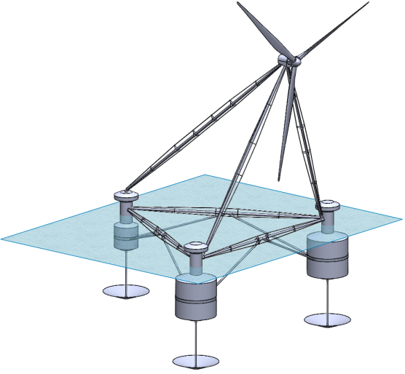
CLOSING REMARKS
For ALL true integrations of energy storage with wind, yaw bearings are bad!
Floating wind turbines may become independent dispatchable power producers in future.
Rear Buoy
(incl. expndr-gen)
φ16m, H=19m
Front Right Buoy
(incl. hot store)
φ28m, H=32m
BYSS* platforms good!
Onboard storage good
Thermal is only option.
Thermal mass = ballast!
10MW system with
1GWh(e) storage.
Front Left Buoy
(incl. cold store)
φ28m, H=32m
* BYSS = Body-Yawing Semi-Submersible

Slide 40

Thanks for listening.
Seamus.garvey@Nottingham.ac.uk
Acknowledgments: EPSRC & InnoVATe-UK

Slide 41
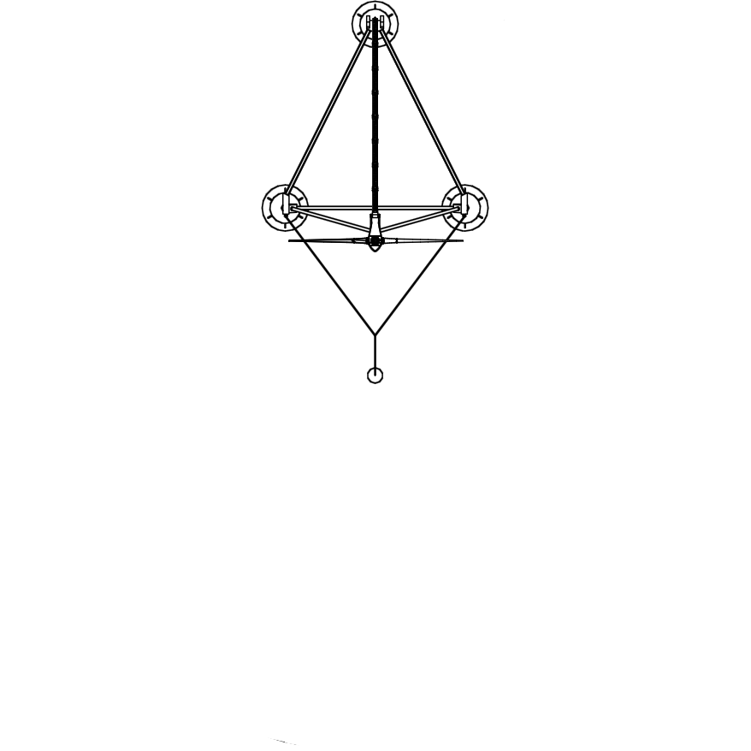
BYSS PLATFORMS do not waste sea-space
A single offshore wind turbine installed on a BYSS foundation could “occupy” significant space.

Slide 42
BYSS PLATFORMS do not waste sea-space
Offshore wind farms never comprise just one turbine..

Slide 43
Relative sizing of PMGs and
WindTP
Both Permanent-Magnet Generators (PMGs) and the WindTP machine are sized on torque, T.
T ∝ D³ , P ∝ D² ⇒ T ∝ P ^{(3/2)}.
Weight ∝ T (if machine proportions remain the same)
(~360 Tons for the SIEMENS 6MW Turbina Sapiens machine … ~3.5MNm torque (?) )
Machine volumes give some sense of the relative sizes:
For PMG machine … the volume of direct interest is the cylinder contained by the airgap.
For WindTP machine … the volume of direct interest is the inlet swept volume.

Slide 44

Relative sizing of PMGs and
WindTP
PMG sizing.
Airgap shear stress is the determining quantity … $τ_{a/g}=$ ~~50kPa for good PM machines
Torque $=\left(πDL\right)×τ_{a/g}×\left(D/2\right)=τ_{a/g}×V_{rotor}×2.$ $V_{rotor}=135 m3$
WindTP sizing.
Intake pressure ($p_{i}=$2MPa) and pressure ratio ($r=25$) determine the torque.
Torque $=\frac{Energy−per−Rev }{2π}=\frac{p_{i}×V_{swept}×\left(r^{.285}−1\right)/0.285}{2π}=V_{swept}×1.68{×10}^{6}$
$$V_{swept}=2.08 m3$$

Slide 45
Relative sizing of PMGs and
WindTP
Reference Comparison:.
Prototype WIndTP machine is rated at 75kW. Total mass of main compressor ~1.5 tons.
VESTAS V17 (75kW) head mass is >6 tons!
Scaling down from SIEMENS (Turbina Sapiens) 6MW machine.
360/(6000/75)^{1.5} = 0.5 tons
360/(6000/75) = 4.5 tons
Broad conclusion:: WindTP is probably comparable in weight to PMGs at large scales with proper engineering

Slide 46

Some more Components
WindTP

Slide 47

Some more Components
WindTP

Slide 48

Some more Components
WindTP

Slide 49


Some more Components
WindTP

Slide 50

Some more Components
WindTP

Slide 51

Some more Components
WindTP

Slide 52


Some more Components
WindTP

Slide 53

Early indications of high compressor efficiency
Preliminary experience with displacer seems very promising
75kW machine ~10m blade tip radius ~10 rad/s.
Rated torque ~7.5kNm. Unloaded loss torque … ~0.2%.
25
20
5
0

Slide 54

Standalone E.S. systems competing with
WindTP
Only thermo-mechanical energy-storage solutions can compete as storage with timeframes of 10 – 100 hrs.

