Slide 1
A latent heat pump (LHP) technology
with ice slurry as media
How ice slurry technology can unlock the electrification of winter heating in Northern Europe
Ziping Feng（Ph. D, Prof.）
Email: fengzp@ms.giec.ac.cn
Mobile: +86-13570091132
Laboratory of Energy Storage Technology
Guangzhou Institution of Energy Conversion, Chinese Academy of Sciences

Slide 2
Contents
1, Ice slurry generating process and its application
2, The principle of latent heat pump with ice slurry as media
3, Economical efficiency of latent Heat Pump

Slide 3

Ice Slurry Generating Process: Type 1-Indirect Cold Source
≤0.5℃
Ice Crystal Filter
Chiller
0℃
-1℃
Crystallizing Tank
Water Pump
-2℃
Crystallizing Interrupter
-3℃
Glycol Pump
Ultrasonic Generator
PHE (Subcooled Water to Glycol Solution
Ice Slurry Pipe
Ice-Rich Layer
Water Layer
Water intake pipe

Slide 4
Ice Slurry Making Process: Type 2-direct Cold Source
≤0.5℃
Ice Crystal Filter
Chiller
0℃
-1℃
Crystallizing Tank
Condenser
Water Pump
-2℃
-3℃
Throttle Valve
Ultrasonic Generator
Crystallizing Interrupter
PHE (Subcooled Water to Glycol Solution
Glycol Pump
Ice Slurry Pipe
Ice-Rich Layer
Water Layer
Water intake pipe

Slide 5
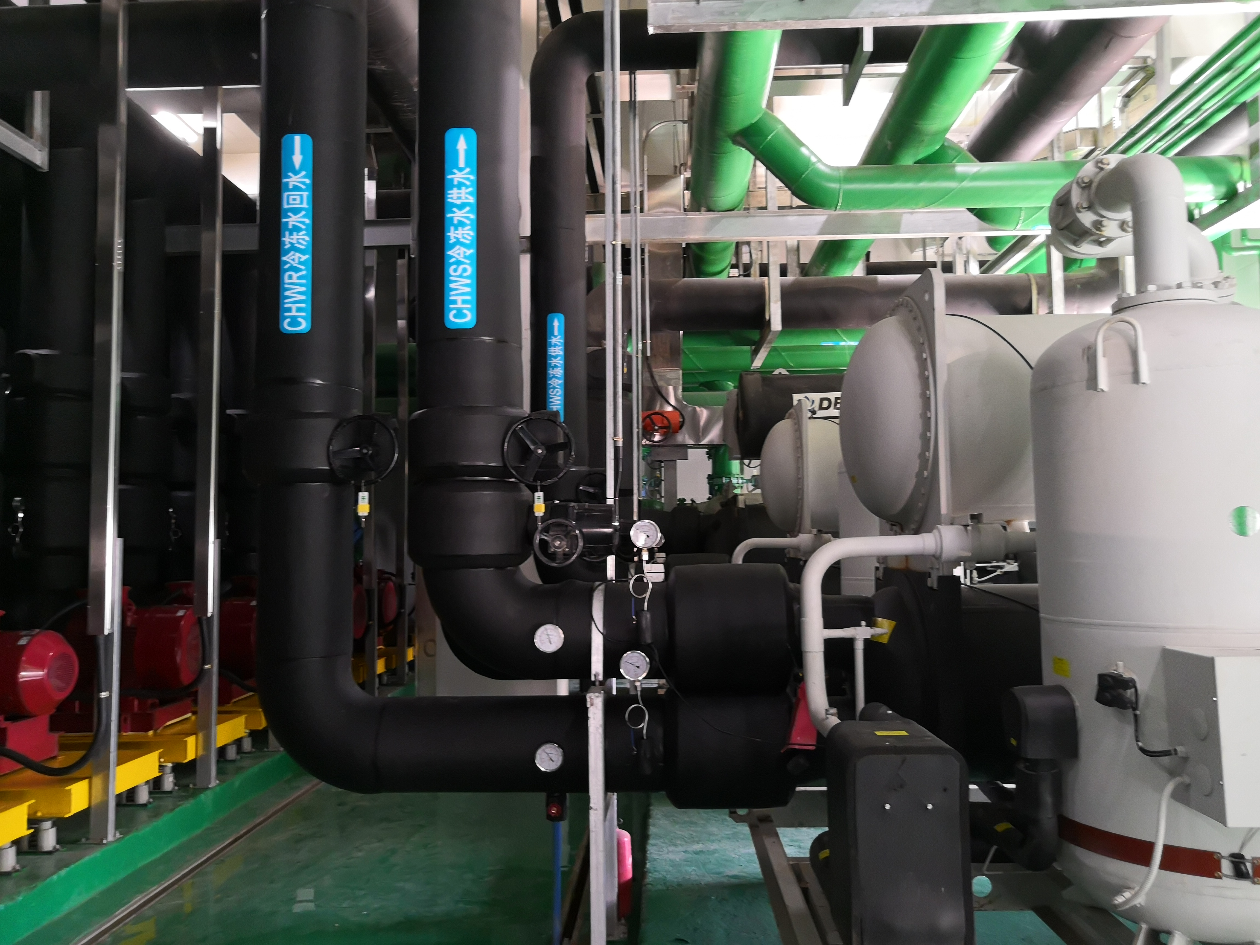
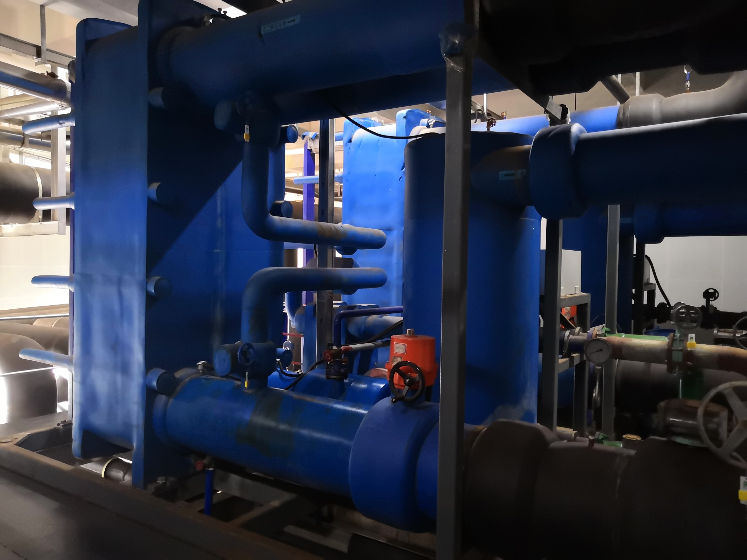
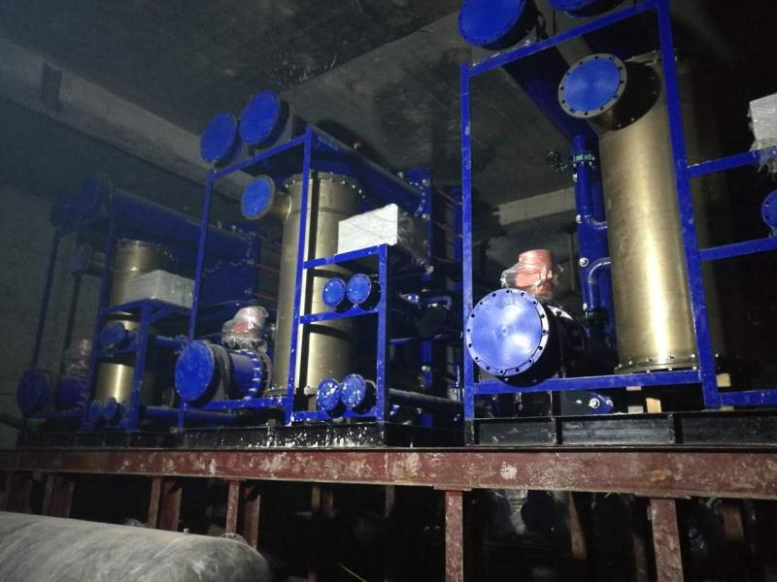
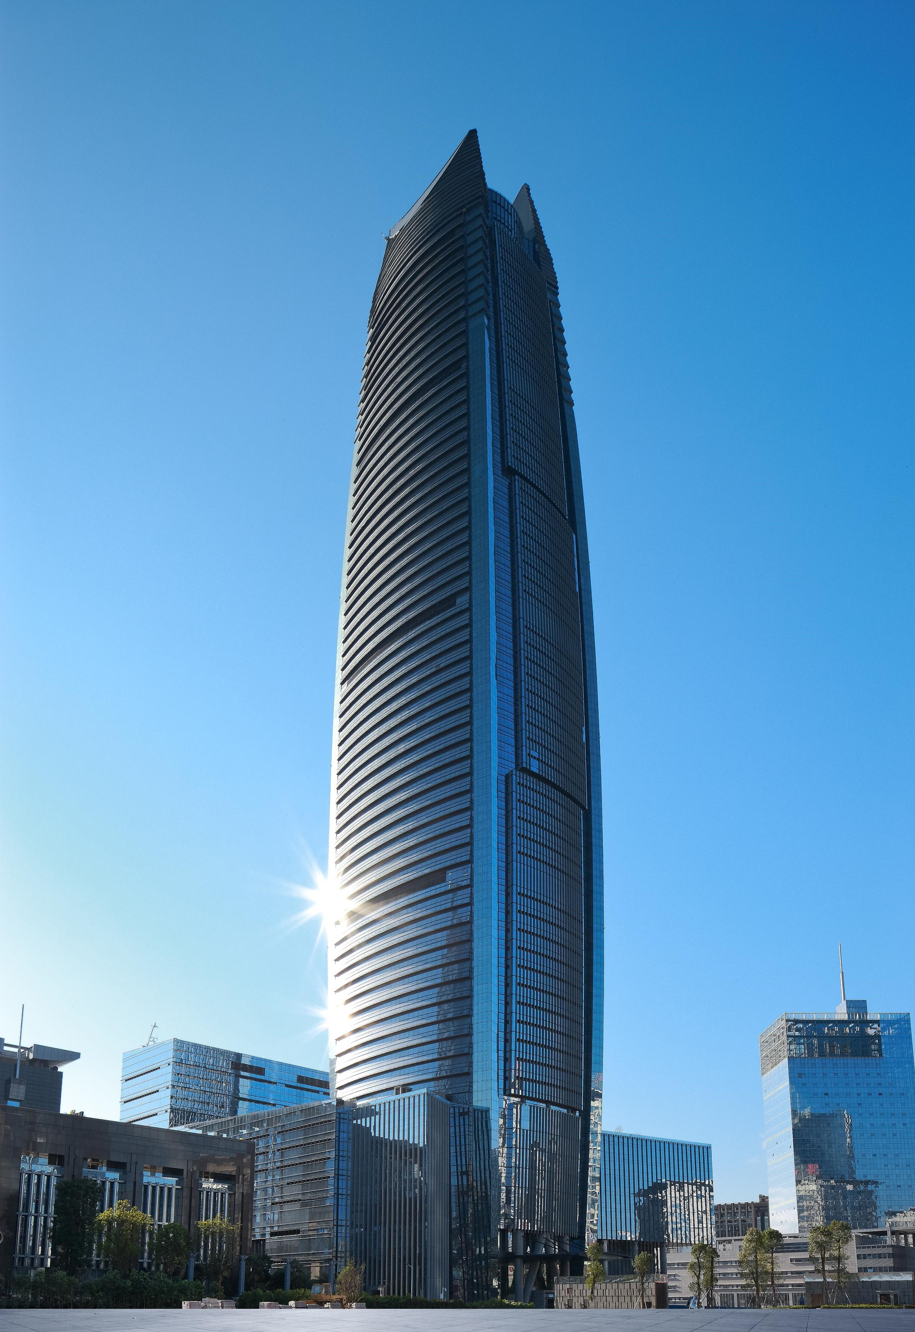
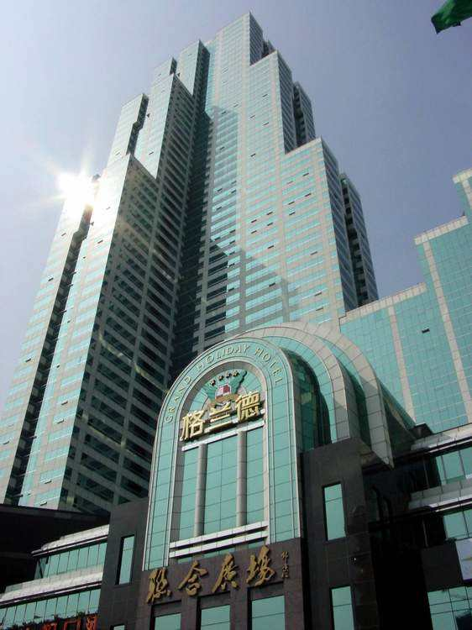

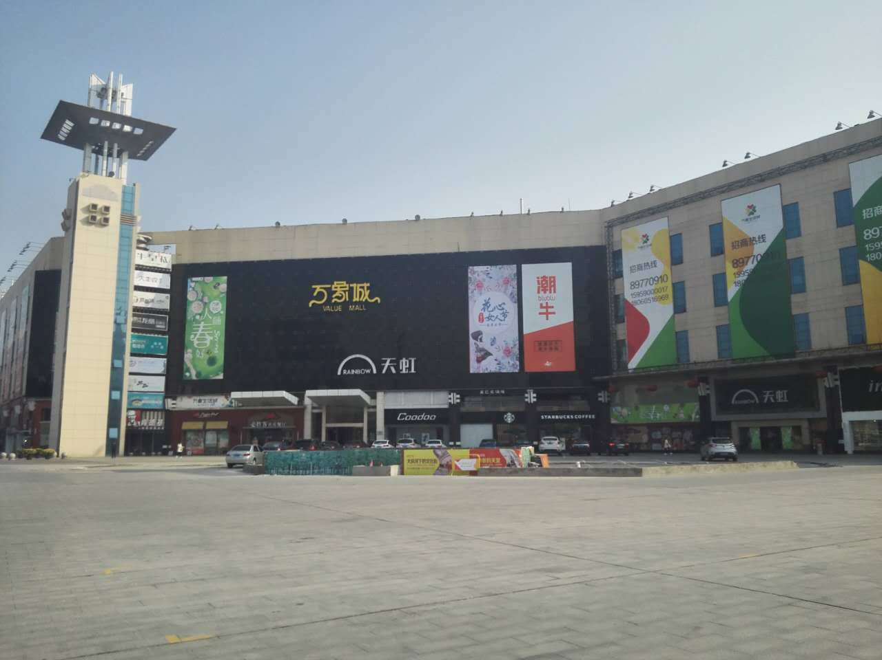
More than 30 demonstration projects thermal storage with ice slurry have been operated in China since 2009.
The total installed capacities have been accumulated to 15,000 USRT (52,000 kW).

Slide 6
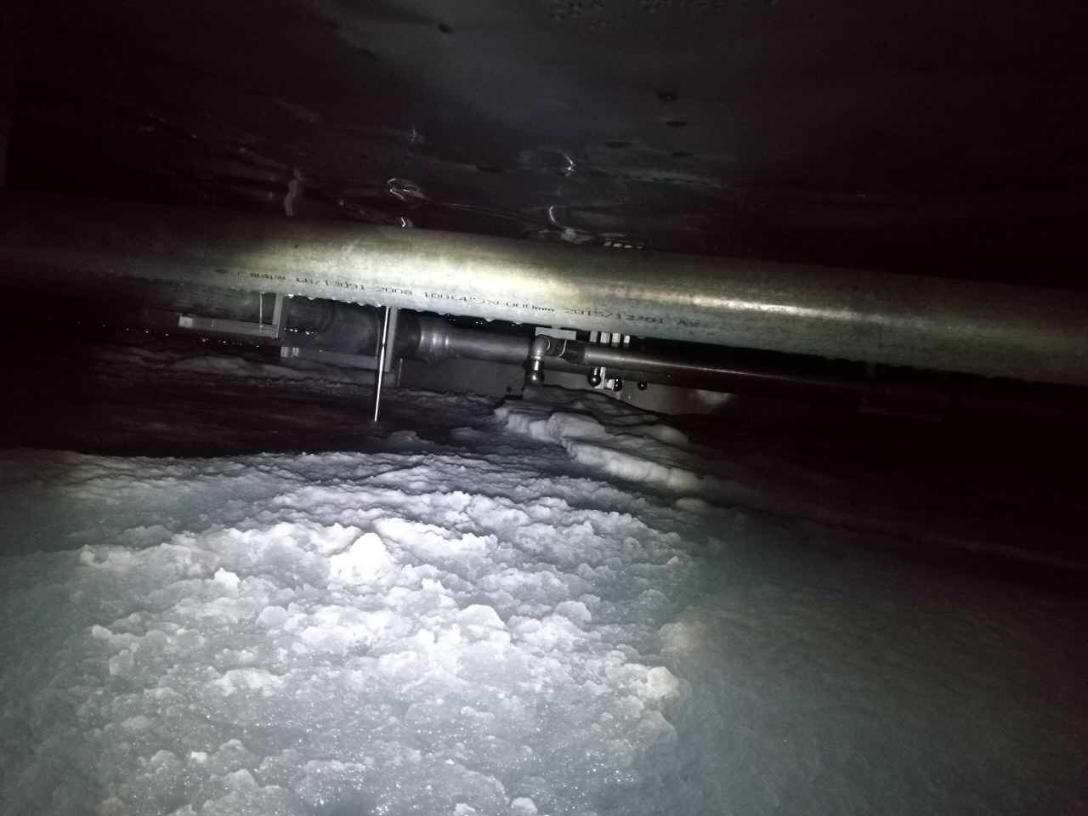
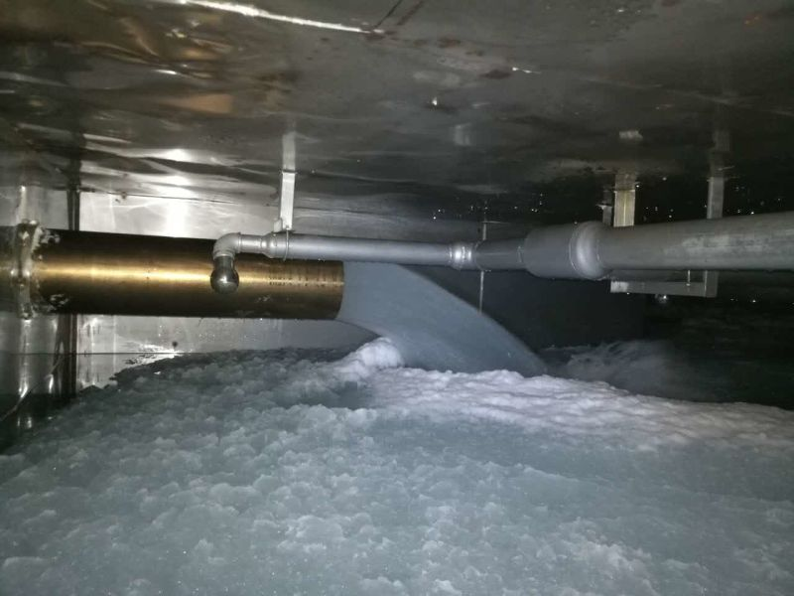
Ice Slurry in tank

Slide 7
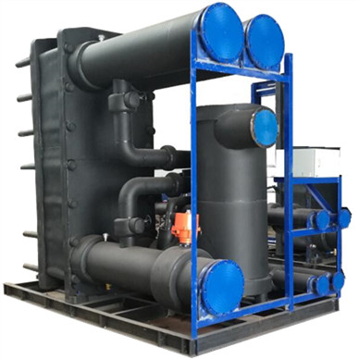
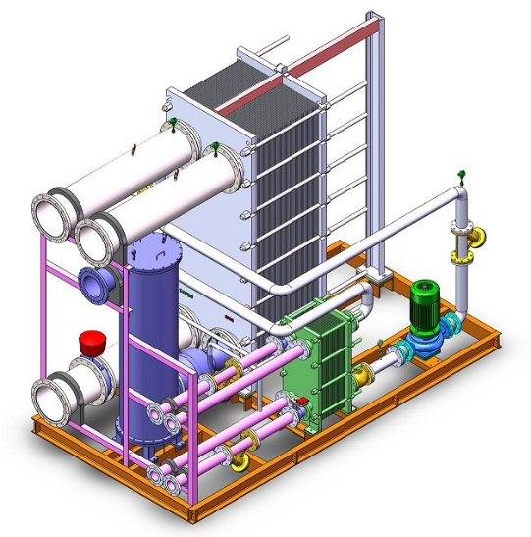
Dynamic Ice Slurry Unit (DISU)
——Indirect type: DISU-R
Not include chiller
A secondary refrigerant loop (glycol solution) is necessary to link the DISU-R with a third-party chiller
The refrigerating capacities are from 50~450 Rt (175~1580 kW)
The chiller’s evaporating temp. is as high as -5.5℃
COP of the system is as high as 3.0

Slide 8
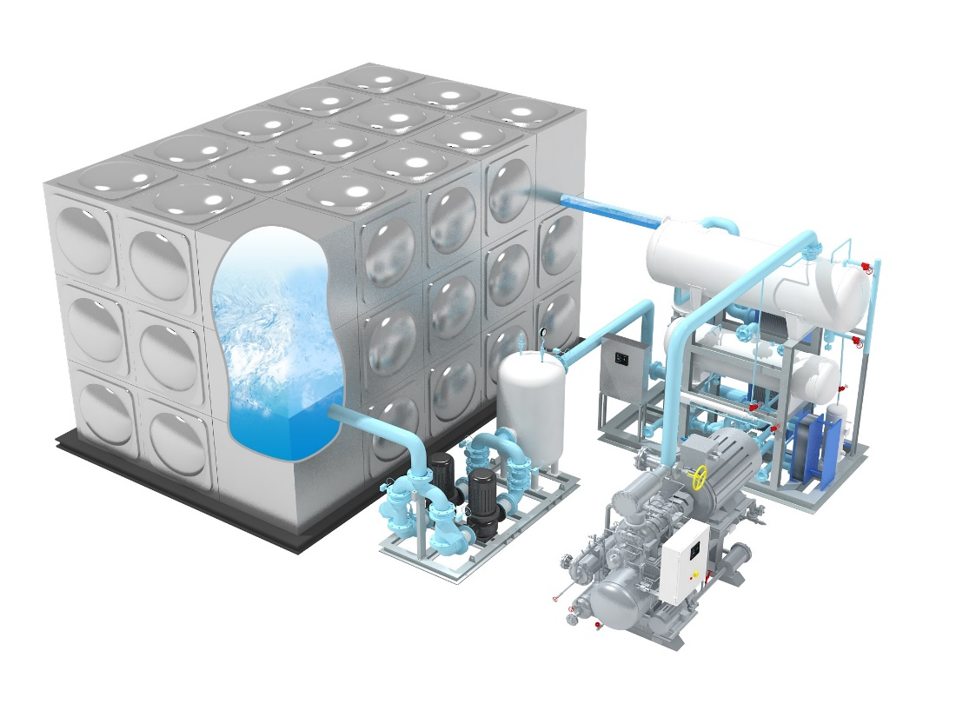
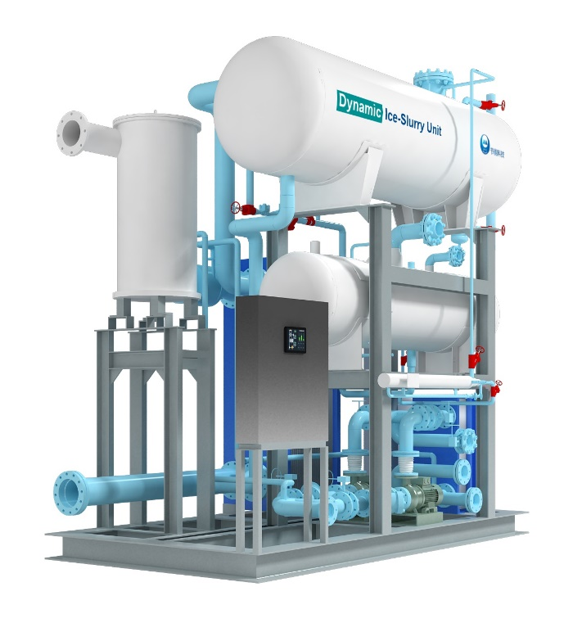
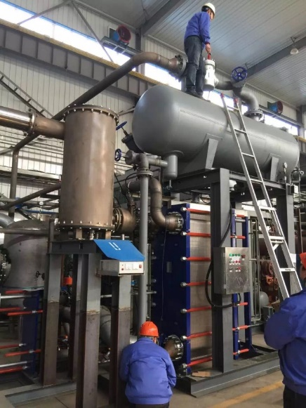
DISU
——direct type: DISU-D
DISS system with DISU-D
Include chiller
No secondary refrigerant loop (glycol solution)
The semi-welded plate heat exchanger for subcooled water is just the flooded evaporator of the chiller
The refrigerants can be chosen form R717 (Ammonia) and R507
The refrigerating capacities are from 20~250 Rt (70~900 kW)
The chiller’s evaporating temp. is as high as -3℃
COP of the system is as high as 4.0
DISU-D

Slide 9
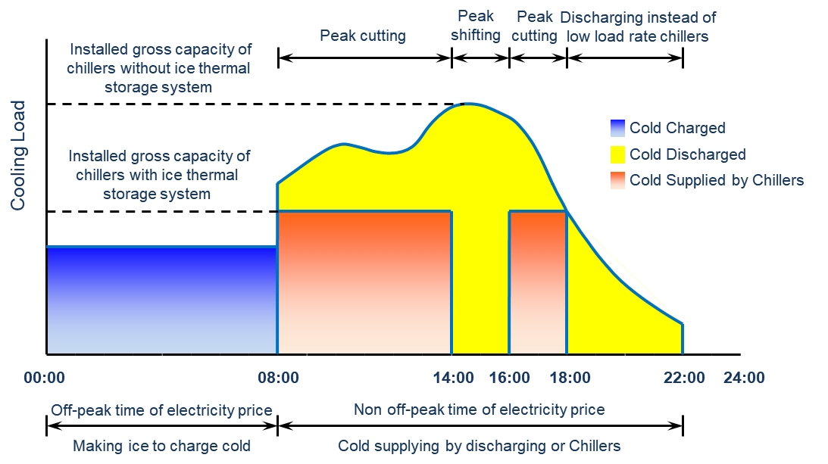
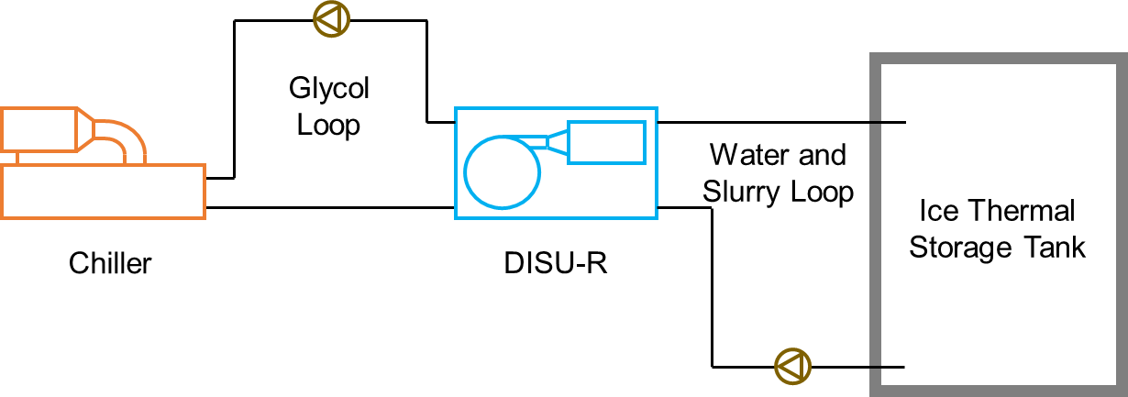
1. Applications in Air Conditioning
System Sketch of A/C Applying DISU-R
Concept of Ice Thermal Storage A/C System

Slide 10
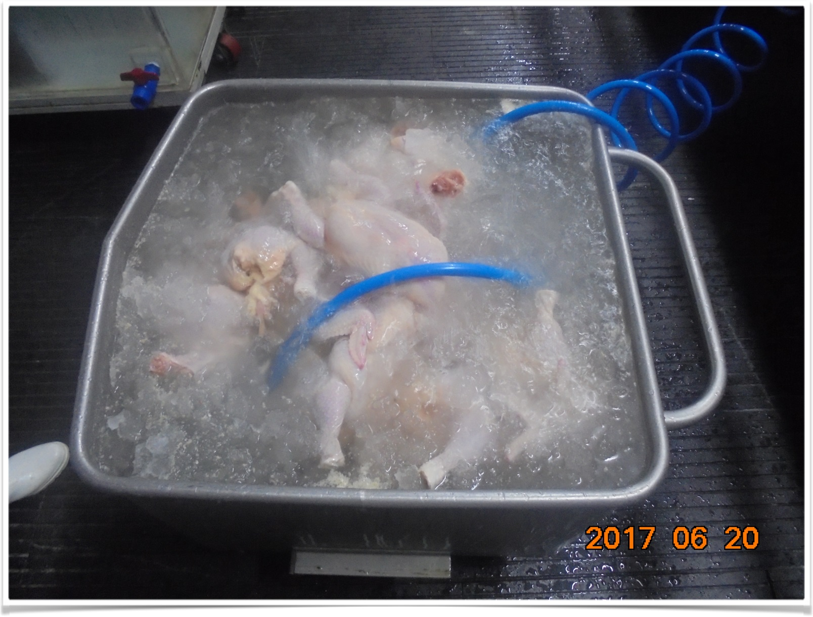
2. Applications in Industrial Cooling
Pasteurized milk with higher temp.
Water back into ice slurry tank
0~1℃ fresh water (from ice slurry tank)
4℃ Milk
Pasteurized milk processing using ice slurry
Chicken cooling (to 4℃) using ice slurry

Slide 11





Applications in Industrial Cooling
Milk
Meat
Sea food
Vegetable
Beverage
Ice Slurry of Fresh Water → Optimal industrial cooling source
Ice Slurry of Fresh Water – Very close to 0℃ – Easy to Cool the products to 4℃
SAFE
SANITARY
SAVING
STABLE

Slide 12
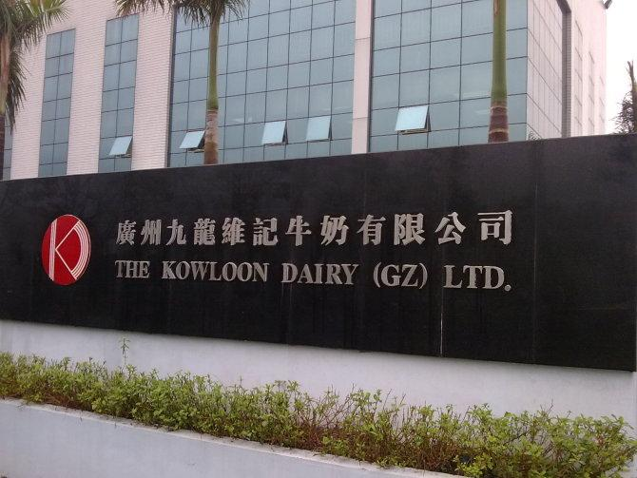
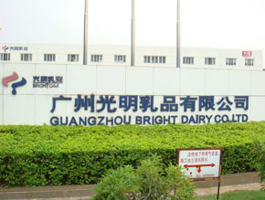

So far, more than 5 dairy factory cases which use ice slurry (fresh water) as cooling source have been brought into operation successfully in China.

Slide 13
Contents
1, Ice slurry generating process and its application
2, The principle of latent heat pump with ice slurry as media
3, Economical efficiency of latent Heat Pump

Slide 14
What is a Latent Heat Pump (LHP)?
Based on the experience of thermal storage, we found that ice slurry can be used for heating in winter season. Thus, a so called “latent heat pump” is developed and has been successfully used for the heating of a residential building.
The theory of Latent Heat Pump is: in cold region, if we use traditional water/ground source heat pumps to provide heat, we can obtain less than 5 kcal/kg sensible heat from the 5℃ water source (with 5-degree temperature difference). But, if we further change water into ice slurry, then we can obtain additional 85 kcal/kg latent heat from water, which is almost 18 times to that of a traditional water/ground source heat pump. Also, the amount of circulation water is only 1/18 comparing to a common water source heat pump.
It should be mentioned that, this technology can be realized only with ice slurry because the ice should be removed away from the heat exchanger surface immediately whenever it is generated.

Slide 15
Daily water consumption for a Latent Heat Pump (per m2)
 | Average daily water consumption kg/(m².day)
 | Harbin | Beijing | Wuhan | Zhengzhou
Low-rise residential | 12.37 | 10.48 | 8.28 | 8.65
Multi-storey residence | 7.95 | 6.98 | 5.52 | 6.06
Office building | 5.15 | 4.37 | 3.45 | 3.60
Hospital | 12.37 | 11.35 | 8.83 | 10.38
Hotel | 10.60 | 9.60 | 7.72 | 8.65
Shopping mall | 6.18 | 5.67 | 4.41 | 5.19
For a 200m2 house, 1-2 ton water is enough for 1 day.

Slide 16
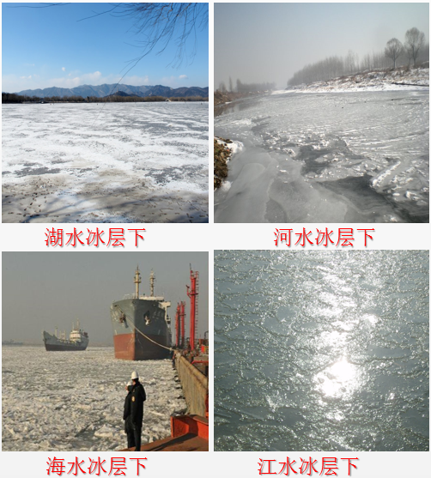
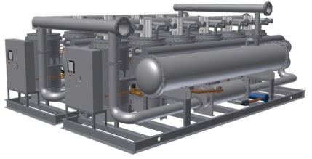
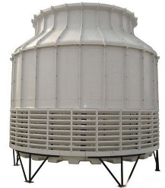
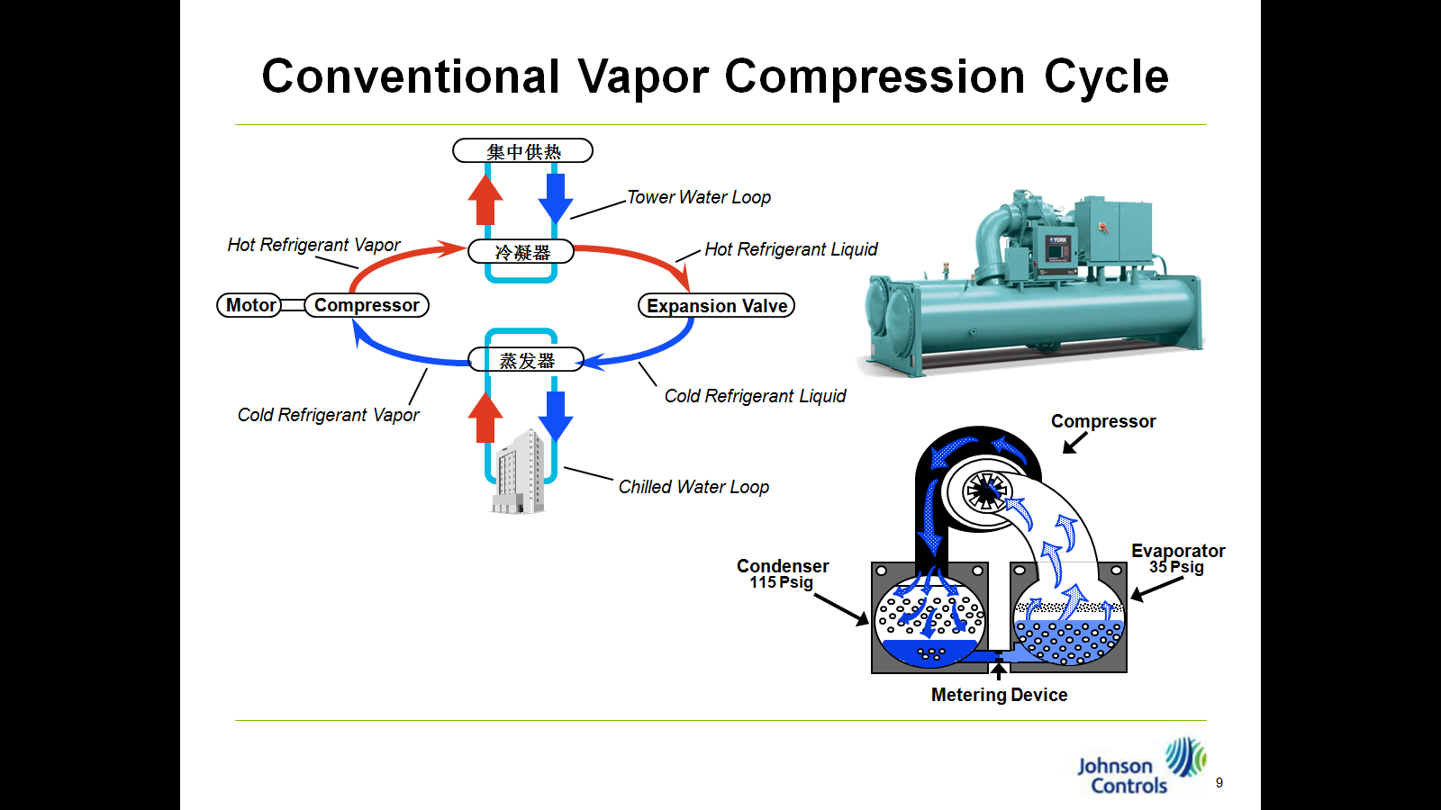


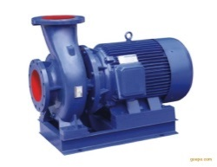

Type 1: Abandoned Type Latent Heat Pump
If the building is nearing to the water source, then we can directly abandon the ice slurry to water source.
Ice separated from slurry and abandoned
Cooling tower（Only runs in summer）
Cooling users
Heat pump
Heating users
DISU
Water intake under ice in rivers, lakes and seas
Glycol loop
Filter

Slide 17


Type 2: Storage Type Latent Heat Pump
If the building is not near to the lake or river, then we can use a water tank to keep ice slurry, and ice slurry can be melted during the daytime by solar energy. In this case, even the tap water can be used as heat source.
Ice slurry storage pool
Solar energy or other low grade heat energy
Cooling users
Cooling tower（Only runs in summer）
Heat pump
DISU
Heating users
Glycol loop
Water supplement

Slide 18
Possible application methods-1,for home heating in EU
The tap water can be used, for example, 1-2 tons per day. This cost should not be too much for a British family.
The initial cost of the latent heat pump is a little high than the common heat pump, but not too much. However, the heating ability could be guaranteed in cold season.
If the outdoor temperature is above the frozen point, Ice slurry will be melt by sunshine during the daytime, so that the tape water can be recycled.
If the outdoor temperature is under the frozen point, the ice slurry can be used to build a small ski slope for children, or used to build snowman, it is also a good point for family.

Slide 19
Possible application methods-2,for commercial buildings
For those buildings near to the water source (river, ocean, or there is a swimming pool), the latent heat pump is a good choice. The ice slurry can be directly poured into the rive, ocean, or the swimming poor.
If the building is far away from the water source, tap water can also be used.
A problem is where to deposit too much ice during the peak days. One possibility is to build a underground pool for seasonal cold energy storage, its efficiency should be higher than the seasonal high temperature heat storage with a ground pool due to the less temperature difference with ground.

Slide 20

A demonstration project in Nanjing city
A “latent heat pump” has been successfully used for the heating of a 25000 m2 residential building in Nanjing province, it shows an excellent performance.
The latent heat pump with ice slurry can be used for anywhere the heating system is required, particularly to combine with water source or ground source heat pumps.

Slide 21
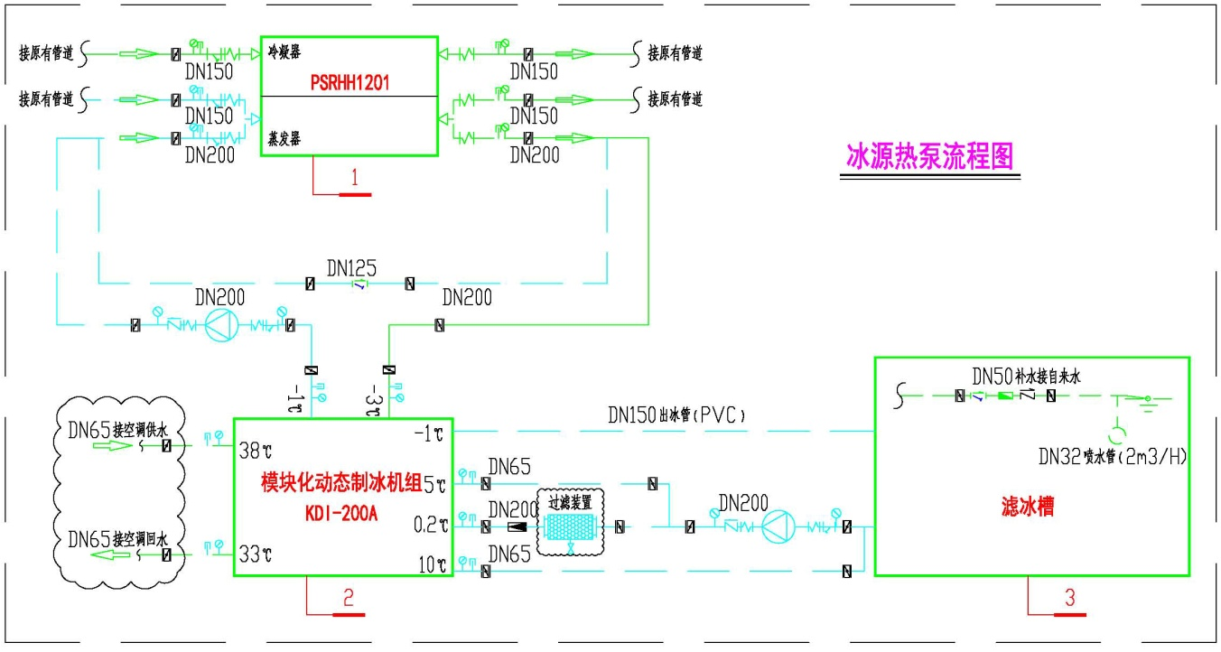
The principle diagram of the demonstration project
Original ground source
heat pump
Glycol solution
Ice slurry generating unit
Ice slurry tank

Slide 22
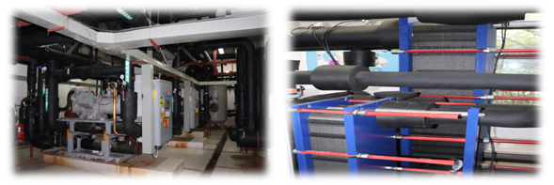
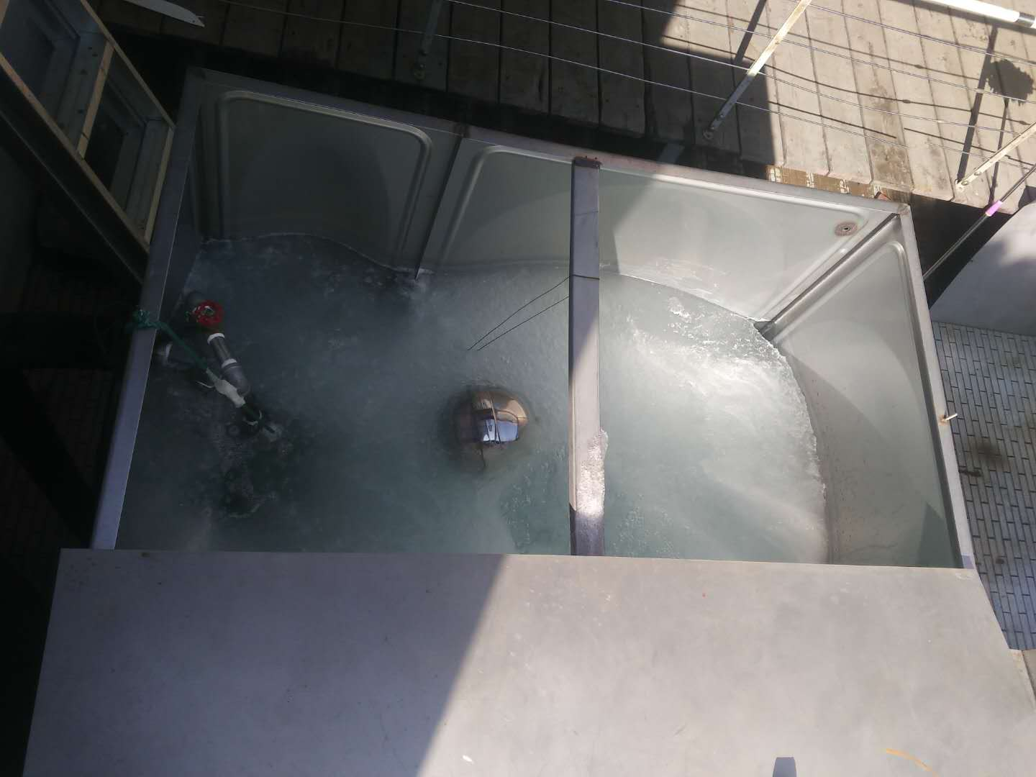
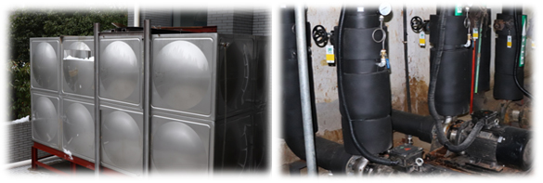
Latent heat pump Dynamic ice slurry unit
Ice slurry
Ice/water separating unit pumps

Slide 23
Contents
1, Ice slurry generating process and its application
2, The principle of latent heat pump with ice slurry as media
3, Economical efficiency of latent Heat Pump

Slide 24
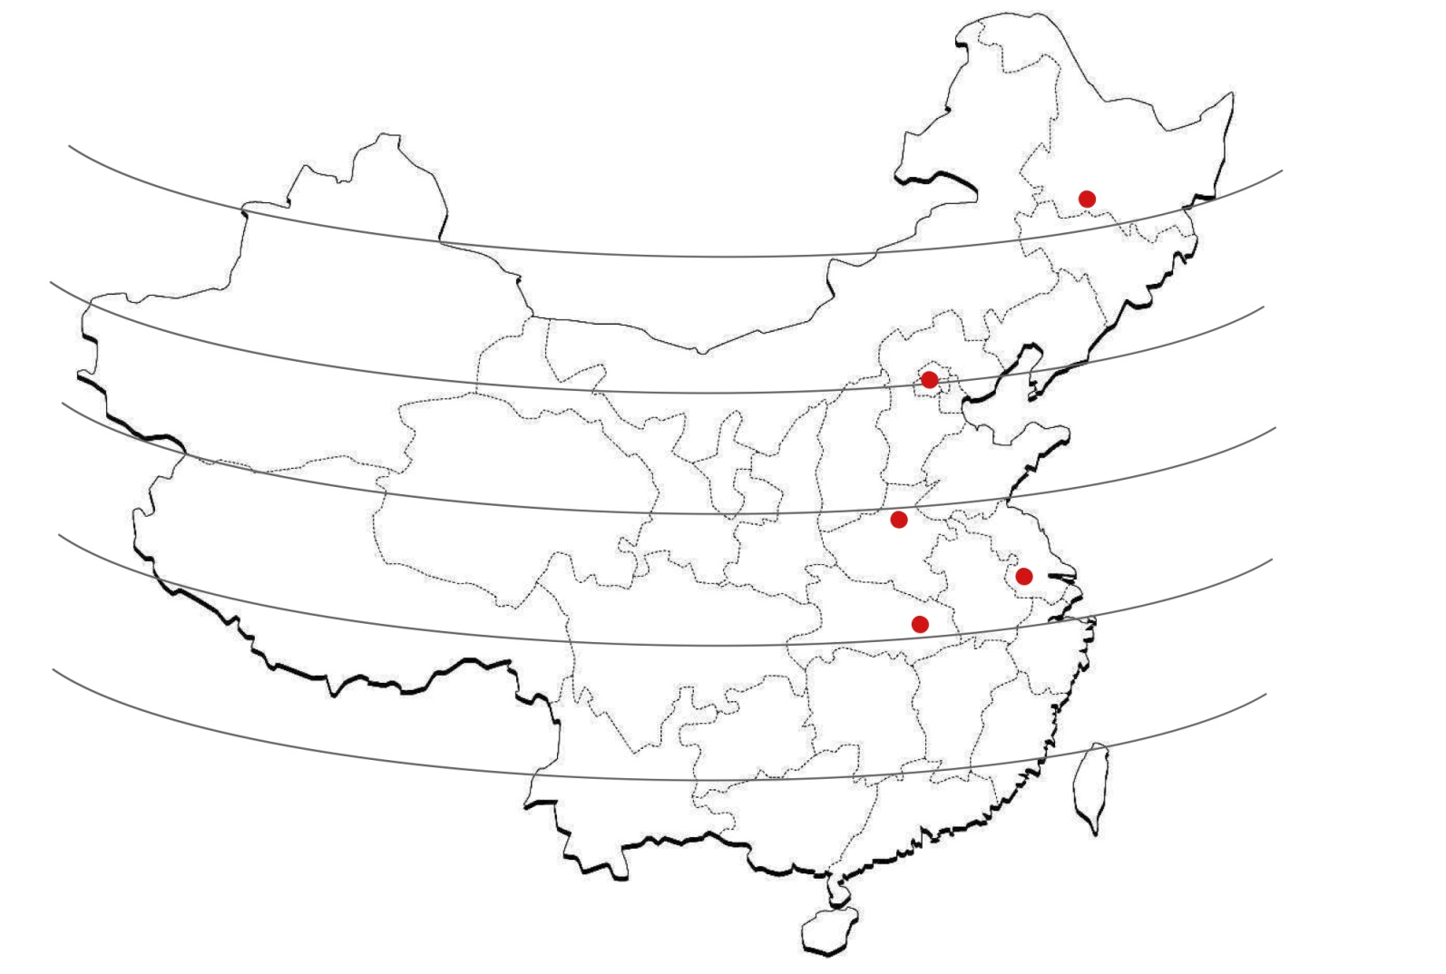
Representive cities and their yearly average temperature
Latitude
45ºN
46ºN (0~11℃)
Harbin
40ºN
40ºN(9~19℃)
35ºN
Beijing
34ºN (12~22℃)
30ºN
Zhengzhou
32ºN (13~22℃)
Nanjing
31ºN (13~22℃)
25ºN
Wuhan

Slide 25
Average COP of Latent Heat Pump in these cities
Assumptions：
① Refrigerant is R134a 。
② Both supercooling and superheating temperature of LHP are 5℃ and the condensing temperature is 43℃。
③ The average heat transfer temperature difference in evaporator is 3℃。
COP of LHP in different cities
Water Temperature/℃ | Harbin | Beijing | Zhengzhou | Wuhan | Nanjing
0≤ t_{ice}＜3 | 4.2 | 4.3 | - | - | -
3≤ t_{ice}＜6 | 4.4 | 4.5 | 4.6 | 4.6 | 4.6
6≤ t_{ice}＜9 | 4.9 | 4.8 | 4.9 | 4.9 | 4.9
9≤ t_{ice}≤12 | 5.2 | 5.3 | 5.3 | 5.2 | 5.3

Slide 26
Initial investments for varies heat pump types
Ground source HP
Air source HP
Latent HP
45ºN
Harbin
¥ 3.5 million
40ºN
Beijing
¥ 2.8 million
¥ 6.0 million
¥ 3.8 million
35ºN
Zhengzhou
30ºN
Nanjing
¥ 2.5 million
Wuhan
25ºN
1000kW heating ability

Slide 27










Operating costs for varies heat pump types
Total electricity costs during heating period
(X10000 yuan)
Electricity costs per m²
(yuan)
73
169
45ºN
Air source HP
27
Harbin
51
67
29
Ground source HP
40ºN
Latent HP
35ºN
Beijing
137
55
30ºN
Zhengzhou
52
66
25
27
Nanjing
25ºN
Wuhan
64
27
32
33
14
14
34
26
26
9
7
7
1000kW heating ability
34
17
9
17
7
4

Slide 28
The initial cost recovery period of Latent Heat Pump (Comparing with Air source HP)
Latent HP
Ground source HP
45ºN
0.3year
2.3year
Harbin
40ºN
1.4year
4.2year
35ºN
Beijing
4.1year
10.8year
30ºN
Zhengzhou
5.1year
13.9year
Nanjing
25ºN
Wuhan
7.4year
19.9year
1000kW heating ability

Slide 29
Thank you for your attention
Ziping Feng
Phone: +86-13570091132
E-Mail: fengzp@ms.giec.ac.cn

